Slide 1
Managing Networking
Identify TCP/IP Fundamentals
Identify Linux Server Roles
Connect to a Network
Configure DHCP and DNS Client Services
Configure Cloud and Virtualization Technologies
Troubleshoot Networking Issues

Slide 2

Topic A: Identify TCP/IP Fundamentals
Exam Objectives:
This topic does not cover specific exam syllabus objectives or content examples.

Slide 3
TCP/IP
The networking protocol that governs Internet communications and many other modern computer networks.
Has rules that control:
How much info to communicate.
What addresses represent what nodes.
How nodes communicate on the network.
What error checking exists.
And more.
The only protocol suite of note.
Notes:
Teaching Tip: Students must understand TCP/IP in order to configure networking on any operating system, including Linux.
Teaching Tip: Gauge students' knowledge of TCP/IP fundamentals and adjust your teaching speed accordingly.

Slide 4
The OSI Model (Slide 1 of 2)
A standard that defines how networking is meant to function in terms of different layers.
7 layers.
Each represents an area of responsibility.
You need to memorize the layers.
Used as a reference point.
Example: Purchase a "Layer 2" switch.
Example: Troubleshoot a "Layer 3" problem.

Slide 5
The OSI Model (Slide 2 of 2)
Layer | Name | Basic Function
7 | Application | Supports apps and end-users.
6 | Presentation | Formats data for use.
5 | Session | Manages connections.
4 | Transport | Enables reliable transmission.
3 | Network | Enables logical addressing.
2 | Data link | Enables physical addressing.
1 | Physical | Enables physical connectivity.

Slide 6
TCP/IP Layers (Slide 1 of 2)
4 TCP/IP layers satisfy 7 OSI layers.
TCP/IP used by Linux and other major OSes.
You need to understand suite and layers.
Can aid in troubleshooting.

Slide 7
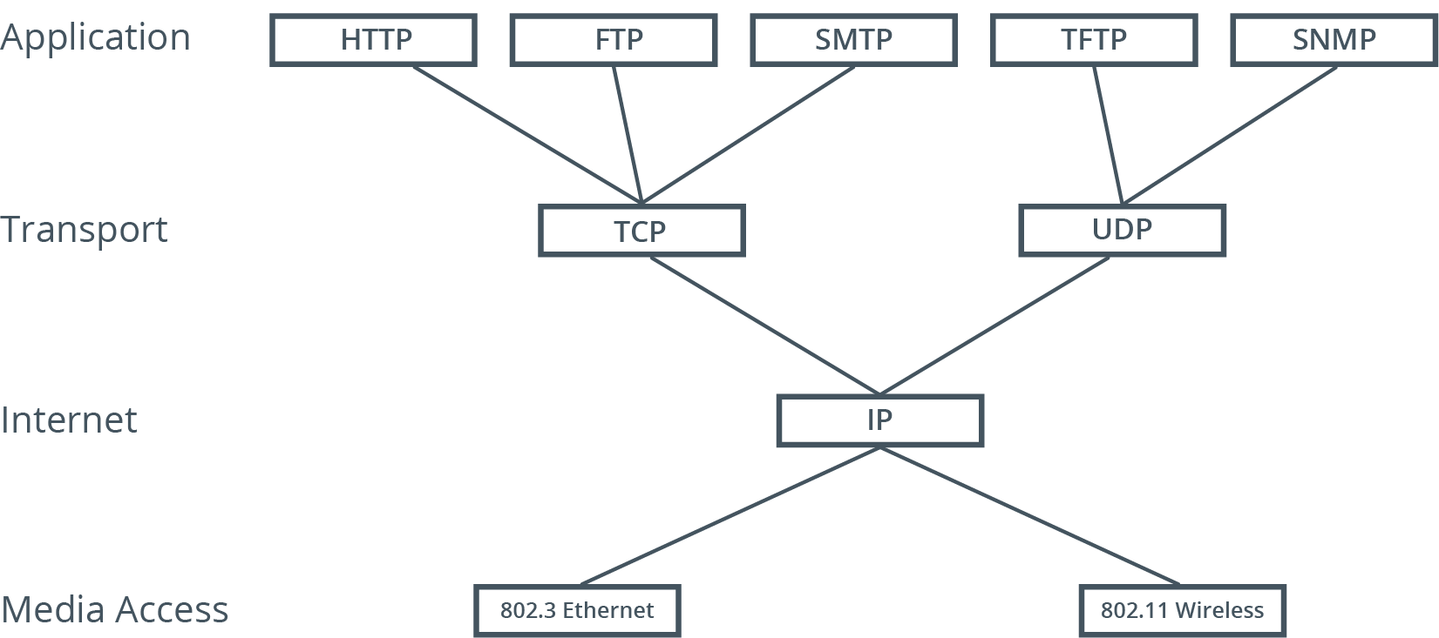
TCP/IP Layers (Slide 2 of 2)

Slide 8
Network Identities
Identifier | Description
MAC address | Unique identity on each NIC. Physical address.
IP address | Logical address. Identifies NIC in network. Show in dotted decimal; computer uses binary.
Hostname | Human-readable name. Also called computer name.

Slide 9
Network Devices and Components
Device/Component | Description
Switch | Centralizes connections for a segment. Can manage traffic. Usually operate at Layer 2.
Router | Controls communications between segments. Can allow or deny certain traffic. Operate at Layer 3.
Media | Usually twisted pair Ethernet cable. Also coaxial and fiber optic cable. Wireless networks forgo cables.

Slide 10
DNS and DHCP
DNS provides name resolution.
Relates hostname with IP address.
Implemented as database on servers.
Can be internal to a network or part of Internet infrastructure.
DHCP provides dynamic configuration of IP addresses.
Nodes need addresses to communicate.
Dynamic configuration more typical in end-user workstations.
Static configuration typical in servers.
Notes:
Teaching Tip: Both DNS and DHCP will be covered in more in depth in the next topic.

Slide 11
IPv4 Addressing
Provides system for managing network identities.
IPv4 address is 32 bits long.
4.3 billion addresses total.
Humans work with address in decimal (e.g., 192.168.2.200).
Computers work with address in binary.
Divided into two portions.
Network identifier defines segment host is on.
Host identifier defines host within that segment.
Subnet mask shows what portion is network ID, what portion is host ID.
Notes:
Teaching Tip: Consider using a telephone number (host ID) with an area code (network ID) as a point of comparison.

Slide 12
IPv4 Classes
Class | Start Addr. | End Addr. | Networks | Hosts per Network | Default Subnet Mask
A | 0.0.0.0 | 127.0.0.0 | 126 | 16,777,214 | 255.0.0.0 or /8
B | 128.0.0.0 | 191.255.0.0 | 16,384 | 65,534 | 255.255.0.0 or /16
C | 192.0.0.0 | 223.255.255.0 | 2,097,152 | 254 | 255.255.255.0 or /24
D | 224.0.0.0 | 239.255.255.255 | N/A | N/A | N/A
E | 240.0.0.0 | 255.255.255.255 | N/A | N/A | N/A

Slide 13
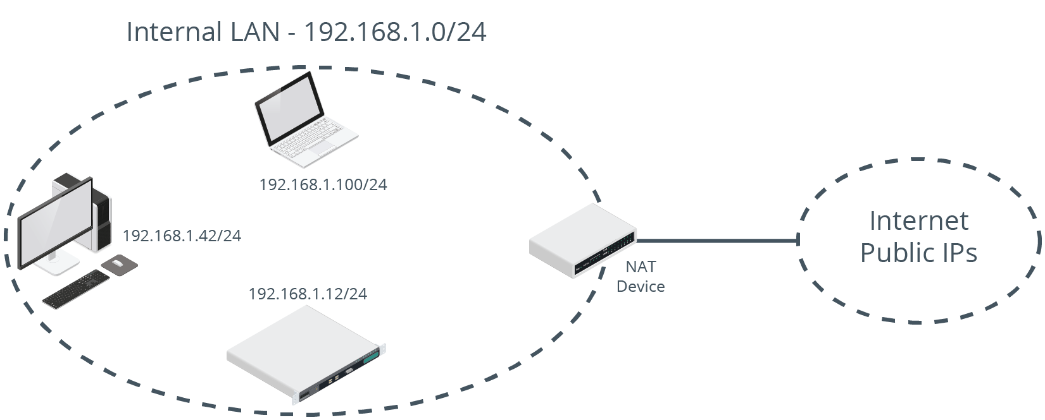
Reserved Ranges

Slide 14
IPv6
IPv4 has many limitations.
IPv6 is its eventual replacement.
Advantages:
Larger address space.
Built-in encryption.
More efficient routing.
Linux is fully compatible with IPv6.

Slide 15
Network Ports
An endpoint in network communication that identifies the type of application-layer protocol used in a communication.
Devices use port numbers to understand how to handle communications.
Port numbers map to application-layer protocols.
Common ports:
22: SSH
25: SMTP
80: HTTP
110: POP3
443: HTTPS
Notes:
Teaching Tip: More application-layer protocols will be discussed later in this lesson.

Slide 16
Network Segments (Slide 1 of 2)
Divide network into segments for easier management.
Better performance.
Better security.
Logical divisions are called subnets.
Identified by network ID.

Slide 17
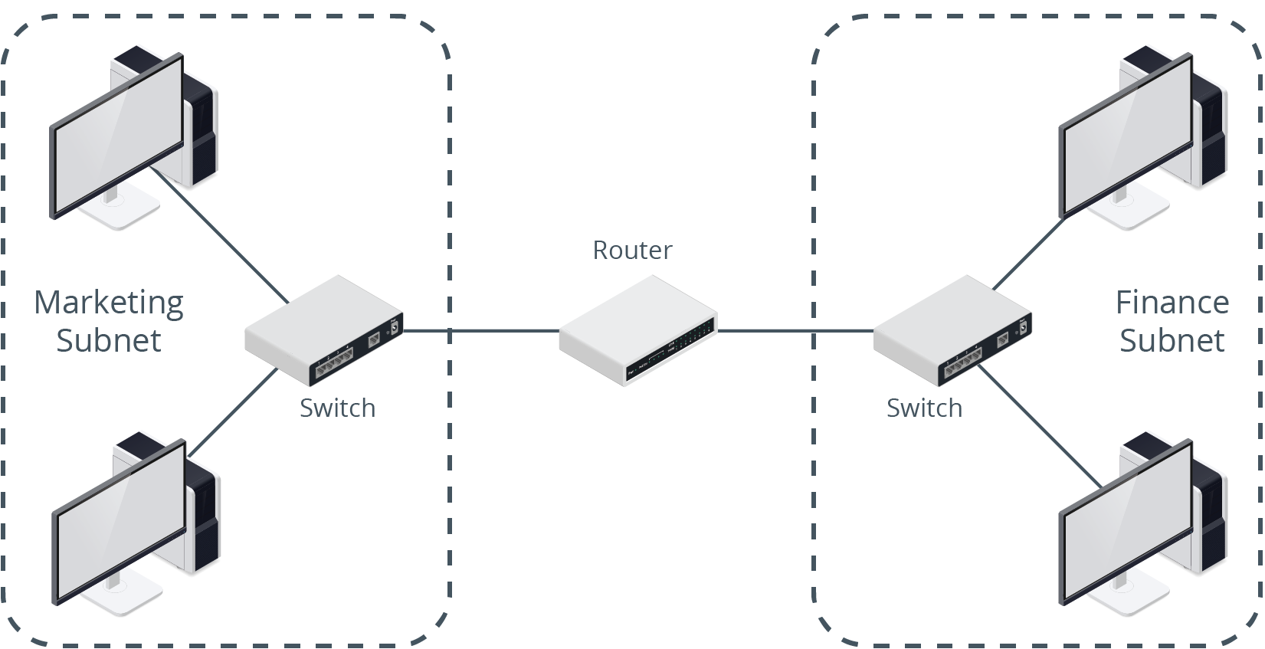
Network Segments (Slide 2 of 2)

Slide 18
Activity: Identifying TCP/IP Fundamentals
You need to review TCP/IP before configuring networking info.
You'll be better equipped to manage Linux networking.

Slide 19
Activity 10-1: Identifying TCP/IP Fundamentals
List at least five application-layer protocols.
ANSWER:
Examples include: HTTP, HTTPS, SMTP, SSH, Telnet, FTP, TFTP, SNMP, DNS, DHCP, etc.

Slide 20
Activity 10-1: Identifying TCP/IP Fundamentals
What are the two transport-layer protocols?
ANSWER:
Transmission Control Protocol (TCP) and User Datagram Protocol (UDP)

Slide 21
Activity 10-1: Identifying TCP/IP Fundamentals
What protocol within the TCP/IP stack is responsible for logical addressing?
ANSWER:
Internet Protocol (IP)

Slide 22
Activity 10-1: Identifying TCP/IP Fundamentals
What are the names and numbers of each layer of the OSI model? What is each layer's function?
ANSWER:
Layer 7 (application) supports software and users; Layer 6 (presentation) formats data for use; Layer 5 (session) manages connections; Layer 4 (transport) manages reliable transmission of data; Layer 3 (network) manages logical addressing; Layer 2 (data link) manages physical addressing; Layer 1 (physical) enables physical connectivity.

Slide 23
Activity 10-1: Identifying TCP/IP Fundamentals
What is the name of the physical address used in Ethernet networking?
ANSWER:
Media access control (MAC) address, permanently set on the network interface card (NIC) by the manufacturer.

Slide 24
Activity 10-1: Identifying TCP/IP Fundamentals
What is the name of the logical address used by the TCP/IP protocol suite?
ANSWER:
IP address

Slide 25
Activity 10-1: Identifying TCP/IP Fundamentals
What is the human-readable name of a network device?
ANSWER:
Hostname

Slide 26
Activity 10-1: Identifying TCP/IP Fundamentals
What are the two components of an IP address?
ANSWER:
Network ID and host ID

Slide 27
Activity 10-1: Identifying TCP/IP Fundamentals
What is the bit length of IPv4 addresses?
ANSWER:
IPv4 addresses are 32 bits in length.

Slide 28
Activity 10-1: Identifying TCP/IP Fundamentals
List the address ranges for Class A, Class B, and Class C IP addresses.
ANSWER:
Class A = 0.0.0.0–127.0.0.0; Class B = 128.0.0.0–191.255.0.0; Class C = 192.0.0.0–223.255.255.0

Slide 29
Activity 10-1: Identifying TCP/IP Fundamentals
List the default subnet mask for Class A, Class B, and Class C IP addresses:
ANSWER:
Class A = 255.0.0.0 or /8; Class B = 255.255.0.0 or /16; Class C = 255.255.255.0 or /24

Slide 30
Activity 10-1: Identifying TCP/IP Fundamentals
What is the IP address associated with the loopback address?
ANSWER:
127.0.0.1

Slide 31
Activity 10-1: Identifying TCP/IP Fundamentals
What IP address range is associated with link-local/APIPA addresses?
ANSWER:
169.254.x.x

Slide 32
Activity 10-1: Identifying TCP/IP Fundamentals
What are two reasons why a network administrator might segment a network?
ANSWER:
Answers may vary, but common reasons are to increase security by grouping hosts with similar security requirements together; and to increase performance through more efficient traffic management.

Slide 33
Topic B: Identify Linux Server Roles
Exam Objectives:
2.5 Summarize and explain server roles.

Slide 34
NTP Services (Slide 1 of 2)
A network protocol that synchronizes a node's time with a designated, definitive time source.
Essential in networking.
Linux systems can be NTP sources or clients.
Uses UDP port 123.

Slide 35
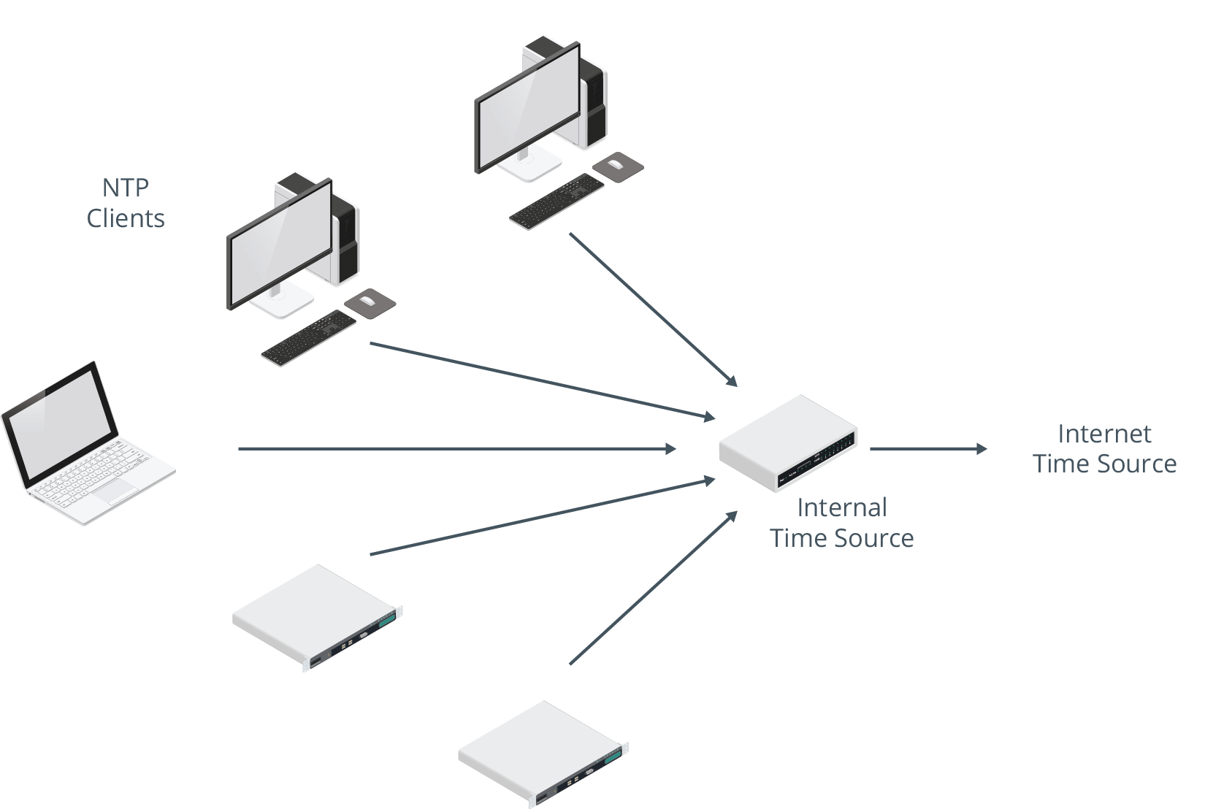
NTP Services (Slide 2 of 2)

Slide 36
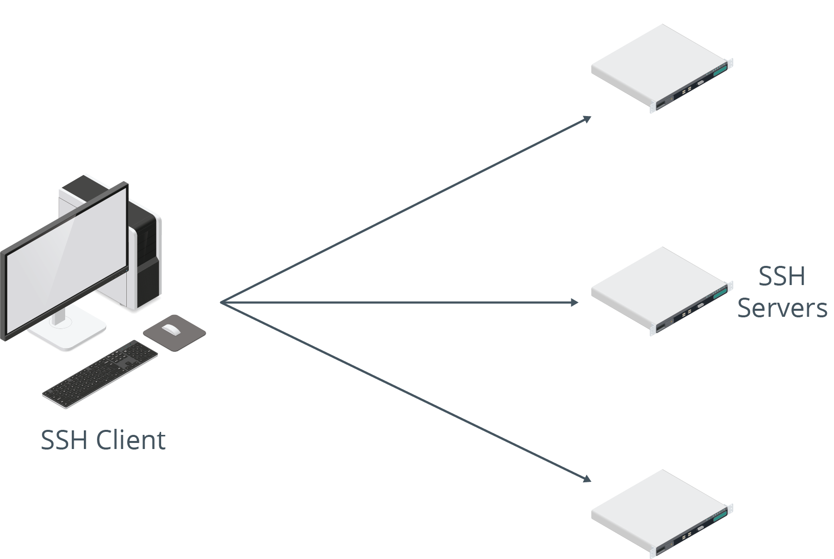
SSH Services
Provides authenticated, encrypted connection to a system.
Used for remote administration.
Can also be used to tunnel other network communications.
Linux can be SSH client and/or server.
Uses TCP port 22.

Slide 37
Web Services
Hosts files and images making up a website.
Clients connect to web server to download files.
Web servers are very common on Linux.
Typically hosted through Apache.
HTTP uses TCP port 80.
HTTPS uses TCP port 443.

Slide 38
Certificate Authority Services
A server that can issue digital certificates and the associated public/private key pairs.
Certificates guarantee identity in a public key infrastructure (PKI).
CA manages enrollment, approval, revocation, etc., for certificates.
Example: Used in HTTPS connections.
Linux servers can be CAs.

Slide 39
Name Server/DNS Services
A network protocol for translating human-readable hostnames into IP addresses.
Can contain records for company's internal network.
Can be part of wider Internet name resolution infrastructure.
Linux can be DNS servers and/or clients.
Uses TCP/UDP port 53.

Slide 40
DHCP Services
A network protocol used to automatically assign IP addressing information to hosts.
Sends address, subnet mask, default gateway, etc.
Client leases configuration from DHCP server.
Linux can be DHCP server or client.
Uses UDP ports 67 and 68.

Slide 41
SNMP Services
A network protocol for collecting and passing device information between hosts.
No longer common due to security concerns.
Linux can be a central SNMP server or an SNMP device.
Uses UDP port 161 and TCP/UDP port 162.

Slide 42
Authentication Services
Centralized authentication makes network:
More secure.
Simpler to manage.
Easier for users to navigate.
Servers hold info about user identities.
User login credentials are compared to stored identity info.
Many kinds of authentication used on Linux.
Examples: Kerberos and LDAP.
Notes:
Teaching Tip: Authentication will be discussed in greater depth in the lesson on security.

Slide 43
Proxy Services
Resides on a system with both trusted and untrusted connections.
Passes Internet requests between two networks.
Example: Web proxy.
Client passes requests to proxy.
Proxy connects to Internet to satisfy request.
Info returned to proxy.
Proxy passes info back to client.
Linux can be proxy server.
Example software: Squid.

Slide 44
Logging Services
Admins need to be aware of how server is operating.
Logs provide info about boot, service performance, user behavior, etc.
Several logging services available for Linux.
Logs can be centralized.
Systems forward logs to one server.
Easier to archive, troubleshoot, audit, etc.
Notes:
Teaching Tip: Logging will be discussed in greater depth in the lesson on security.

Slide 45
Monitoring Services
Many available in Linux.
Some monitor specific apps, others monitor entire OS.
Examples:
top
ApacheTop
Monit
System Monitor

Slide 46
Load Balancing Services
The technique of distributing network traffic or computing workload among multiple devices in a network.
Often used with web server infrastructure.
Web server can easily be overwhelmed.
Load balancing ensures connections are spread across multiple servers.

Slide 47
Clustering Services
The technique of connecting systems together to perform tasks as if they were one system.
Often used with databases in a SAN.
Each cluster is a node and can accept connections.
If one node goes down, other nodes in cluster maintain availability.

Slide 48
File/Print Services
Very common in most networks.
File servers centralize user data.
Better backups.
Better security.
Greater fault tolerance.
Easier access.
Printing can also be centralized.
More efficient.
More cost savings.
Easier to manage paper/toner supplies.

Slide 49
Database Services
Stores large quantities of data.
Enables querying/retrieval of data.
SQL database:
Uses relational tables.
Examples: MySQL, MariaDB, PostgreSQL.
NoSQL database:
Does not use relational tables.
Example: MongoDB.

Slide 50
VPN Services
A method of extending a private network by tunneling through a public network, such as the Internet.
Enables remote users to access internal resources over the Internet.
Useful for users working at home or on the road.
Important because certain networks are untrusted.
VPN encrypts content on client end.
Content decrypted on server end.
Linux can be a VPN server or client.

Slide 51
Virtualization/Container Host Services
Virtual machines (VMs):
Virtualize computer hardware.
Layer of software resides on top of hardware and manages resource allocation.
OSes can be installed in VMs.
Provides same functionality as physical server.
Save on cost and are more efficient to manage.
Example software: Kernel-Based Virtual Machine (KVM).
Containers:
Single host OS runs multiple apps in isolation.
All apps share OS and its resources.
Improve efficiency and management.
Example software: Docker.
Notes:
Teaching Tip: Virtualization will be discussed in more depth in a later topic.

Slide 52
Email Services
Key component of business communications.
Distribute electronic mail within or between organizations.
Example Linux services: Sendmail and Postfix.
Protocols:
SMTP (TCP port 25).
POP3 (TCP port 110).
IMAP (TCP port 143).

Slide 53
Activity: Identifying Linux Server Roles
Develetech help desk wants you to address networking questions.
You'll get a better idea of what server roles you may need.

Slide 54
Activity 10-2: Identifying Linux Server Roles
You want to provide secure connectivity to users in your company to a shared server for web and shell-based command-line access. Which protocols will you choose?
ANSWER:
SSH for shell/command-line and HTTPS for web because they are both secure and standard protocols.

Slide 55
Activity 10-2: Identifying Linux Server Roles
Your Windows users complain that there is no native SSH client in their older version of Windows. What can you recommend?
ANSWER:
PuTTY is a commonly used SSH client for Windows.

Slide 56
Activity 10-2: Identifying Linux Server Roles
You need to provide shared Linux resources to Windows users. Which service can you set up on your Linux system to accomplish this?
ANSWER:
You can set up Samba to create Windows-type directory shares.

Slide 57
Activity 10-2: Identifying Linux Server Roles
Email is an essential network service. Which programs might you select for setting up email services on your Linux server?
ANSWER:
Sendmail or Postfix are common Linux email services.

Slide 58
Activity 10-2: Identifying Linux Server Roles
Mobile devices have created a mobile workforce. Your users need to be able to connect to the corporate network to access shares, printers, and other internal tools. Which service can you set up to enable secure connectivity for your mobile users?
ANSWER:
A virtual private network (VPN) service works well because it encrypts all data between the user's device and the corporate network.

Slide 59
Activity 10-2: Identifying Linux Server Roles
Rose Stanley, a graphic designer at Develetech, has asked for your help. She regularly transfers many very large image files. She wants an efficient way of doing this over the network. What network service do you recommend?
ANSWER:
Answers may vary, but FTP is a good choice because it is designed for simple file transferring within a client/server architecture.

Slide 60
Activity 10-2: Identifying Linux Server Roles
Chris Mason, a sales executive at Develetech, has been told to connect to a particular server to access resources. He has asked you for help because the instructions indicate he should connect by IP address. He cannot easily remember the IP address and has asked you if there is an easier way to connect to the server. What service can you use to make the connection easier for Chris?
ANSWER:
Answers may vary, but DNS is a good choice because it centralizes and streamlines the name resolution process.

Slide 61
Activity 10-2: Identifying Linux Server Roles
Develetech employees have contacted the help desk because they cannot connect to a particular server. Part of your investigation indicates the server has been configured with a dynamic IP address. How could this contribute to the problem and what steps should be taken to address it?
ANSWER:
Dynamic IPs could change, meaning the server's identity on the network has changed, keeping users from connecting to it. A solution is to use a static IP address configuration.

Slide 62
Activity 10-2: Identifying Linux Server Roles
Develetech's security team requires that log files be archived for future reference and audits. Since you are responsible for several Linux servers, how can you make this process more efficient?
ANSWER:
Answers may vary, but you can centralize the log files on a single Linux server.

Slide 63
Activity 10-2: Identifying Linux Server Roles
One of the developers at Develetech has asked for your help. She needs a Linux test environment to verify her application functions as designed. She would like to manage it herself and be able to revert it back to its original configuration after each test. What solution can you suggest?
ANSWER:
Answers may vary, but creating a virtual machine on a platform like KVM is a good choice because it is native to the Linux kernel.

Slide 64
Topic C: Connect to a Network
Exam Objectives:
1.3 Given a scenario, configure and verify network connection parameters.
4.1 Given a scenario, analyze system properties and remediate accordingly.

Slide 65
Hostname Configuration
systemd uses hostnamectl set-hostname to configure hostname.
Must restart service after hostname is changed.
Example:
sudo hostnamectl set-hostname server01

Slide 66
IP Configuration
IP address must be configured on system to use the network.
Also includes subnet mask, default gateway, DNS server(s), etc.
Verify this info early on in troubleshooting process.
Misconfiguration may result in lack of network connectivity.

Slide 67
NetworkManager
A Linux utility that is used to configure a system's networking information.
Includes three interfaces.
Depends on if GUI is installed.

Slide 68
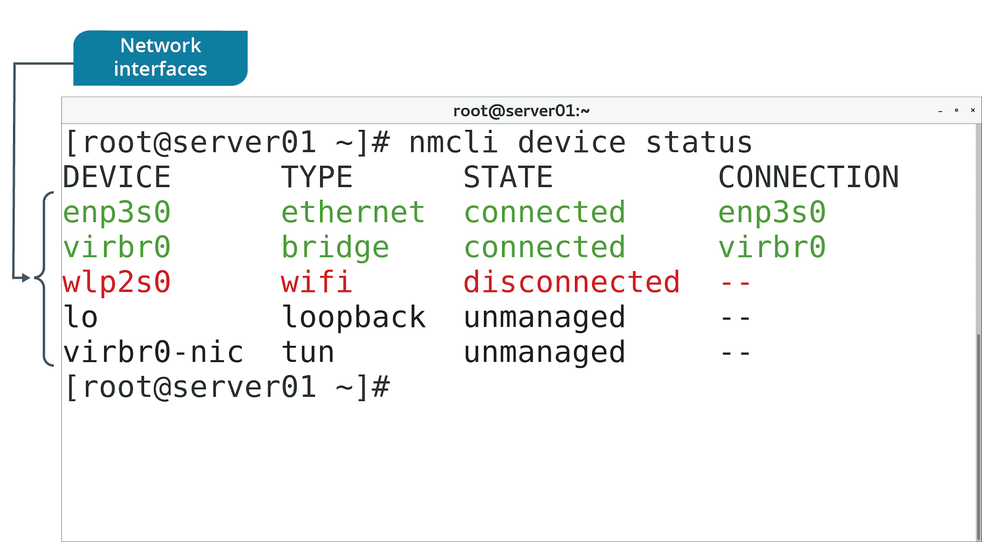
The nmcli Command (Slide 1 of 2)
Most fundamental NetworkManager interface.
Includes subcommands for configuring network info.

Slide 69
The nmcli Command (Slide 2 of 2)
Subcommand | Used To
general status | View summary of network connectivity.
connection show | View identification info for each NIC.
con up {device ID} | Enable specified NIC.
con down {device ID} | Disable specified NIC.
con edit {device ID} | Enter interactive mode to configure specified NIC.
device status | Display current status of each NIC.

Slide 70
The nmtui Utility (Slide 1 of 2)
Another NetworkManager interface.
Calls up text-based user interface.
More visual than CLI, not quite as visual as GUI.
Navigation:
Tab key to move from field to field.
Arrow keys to make selections within field.
Enter key to activate a field.
Spacebar to check/uncheck check box.

Slide 71
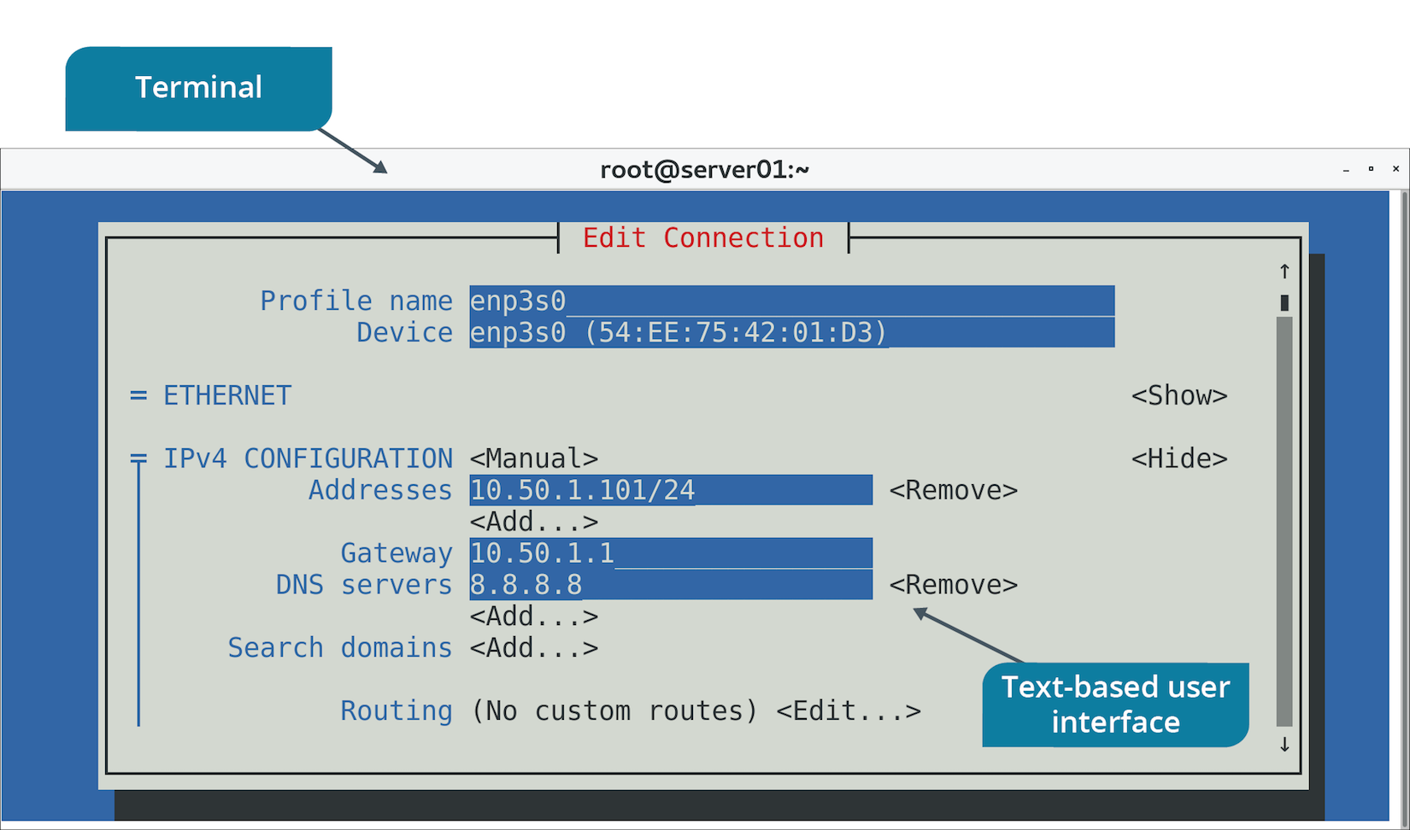
The nmtui Utility (Slide 2 of 2)

Slide 72
The nmgui Utility (Slide 1 of 2)
GUI tool.
Useful for managing workstations.
Enables configuration of many settings.
Will look familiar to end-users.

Slide 73
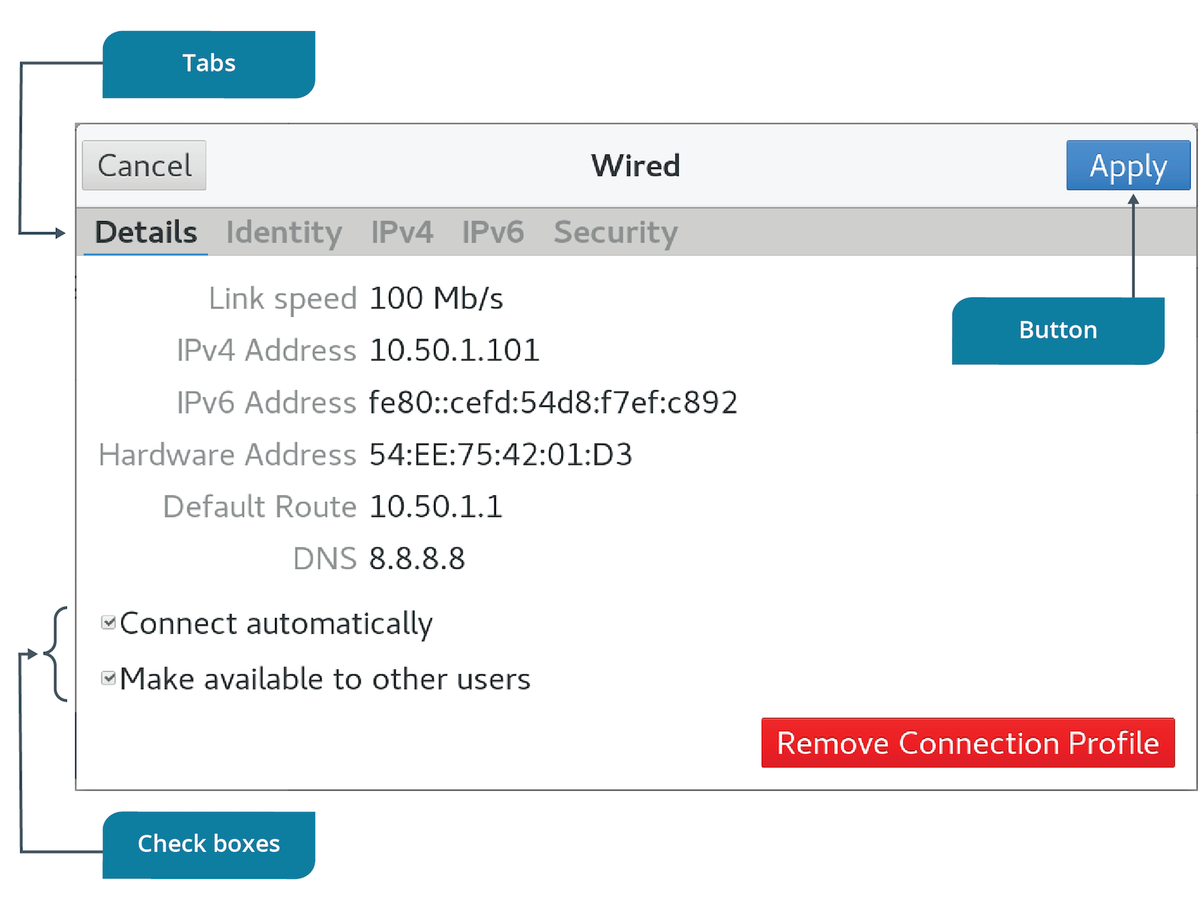
The nmgui Utility (Slide 2 of 2)

Slide 74
The ifconfig Command
Enables user to view current IP addressing info for each NIC.
Early step in troubleshooting.
Shows:
IP address
Subnet mask
Broadcast ID
MAC address
Performance info
NIC name
Officially deprecated in Linux, but still available in some distros.

Slide 75
The ip Command (Slides 1 of 2)
Replaces ifconfig
Produces similar info.
Examples:
ip addr show
ip link
ip link set eth1 up
ip link set eth1 down

Slide 76
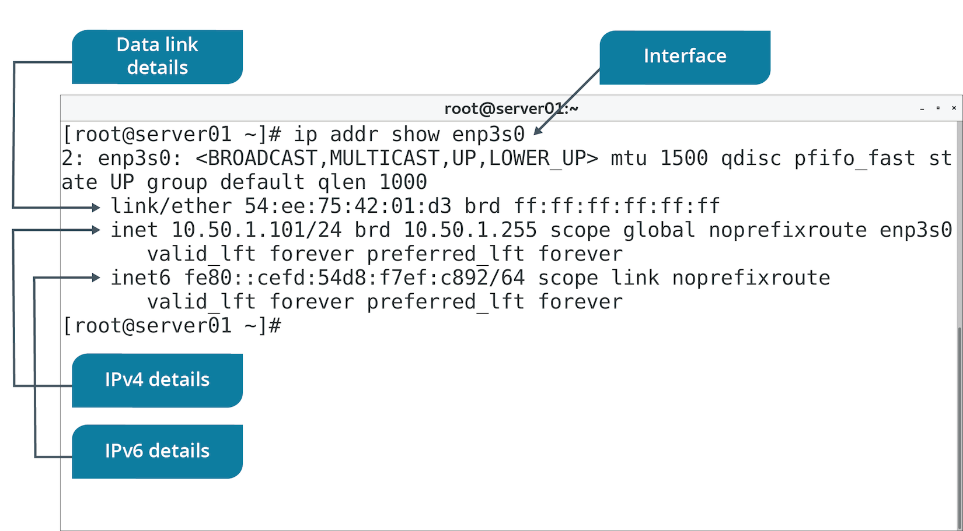
The ip Command (Slides 2 of 2)

Slide 77
The iwconfig Command
Provides wireless NIC configurations.
Settings like SSID, encryption info, etc.

Slide 78
Activity: Configuring the Server's Network Identity
You need to ensure hostname and IP address are correct.
You also need to configure network settings with or without a GUI.
You'll configure both static and dynamic addresses.
Notes:
Teaching Tip: It may be helpful for students to maximize their terminal window while inputting the following commands.

Slide 79
The ethtool Command (Slide 1 of 2)
Manages NIC driver and network configs.
Appears on some distros.
Has many options for info gathering.

Slide 80
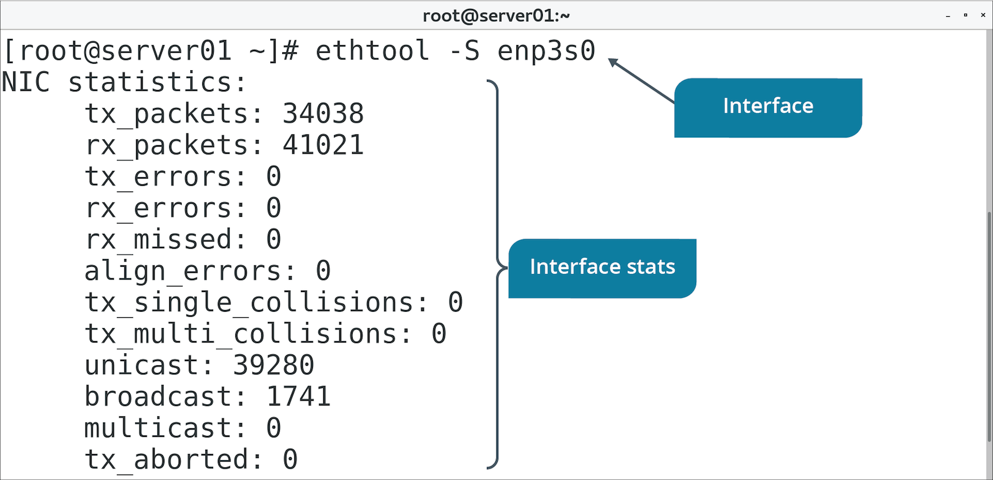
The ethtool Command (Slide 2 of 2)

Slide 81
The brctl Command
Configures network bridging.
Associating two networks together.
Works at Layer 2 with MAC addresses.
Example process:
brctl show
brctl addbr {bridge name}
brctl addif {bridge name} eth0
brctl addif {bridge name} eth1

Slide 82
NIC Bonding (Slide 1 of 2)
The technique of associating two network interfaces together so that they are managed as a single device.
Aggregates bandwidth
Provides fault tolerance/redundancy.
If one NIC fails, other still provides connectivity.
Provides load balancing.
Prevents one NIC from being overwhelmed.
Active/passive setup:
System fails over to second NIC if first NIC fails.
Supported in Linux.
Switch must support EtherChannel.

Slide 83
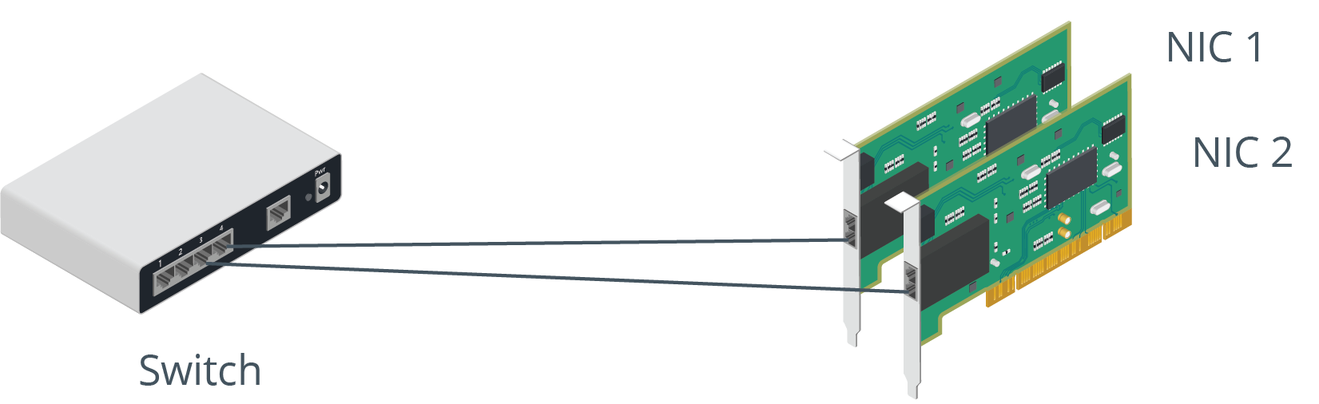
NIC Bonding (Slide 2 of 2)

Slide 84
The /etc/sysconfig/network-scripts/ Directory (Slide 1 of 2)
Contains device configuration files.
NICs, bonds, bridges, etc.
Take form of ifcfg-<NIC>
Used to set NIC as enabled.
Used to set NIC as having a static or dynamic IP address.
Settings vary depending on device type.
Use NetworkManager to edit these scripts rather than a text editor.

Slide 85
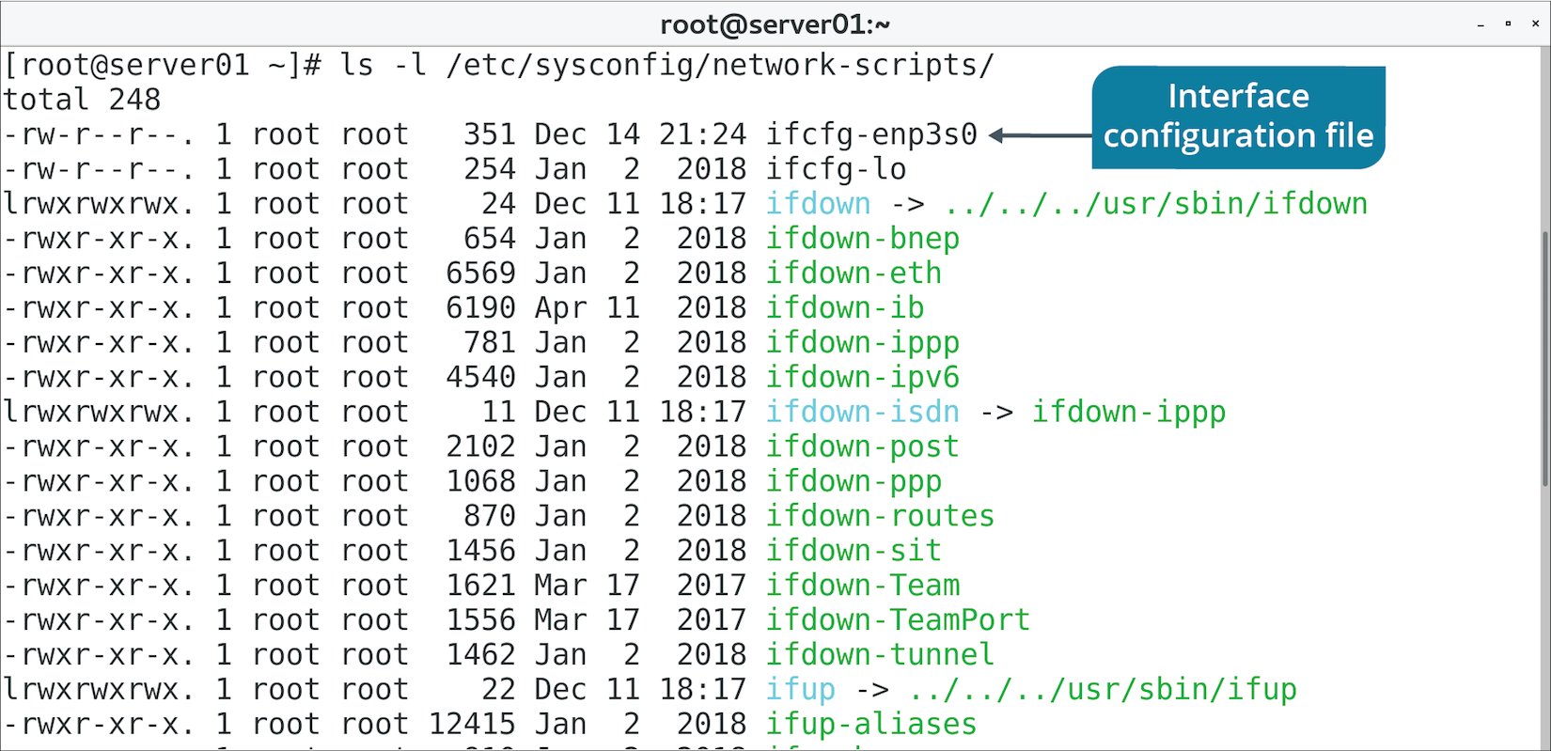
The /etc/sysconfig/network-scripts/ Directory (Slide 2 of 2)

Slide 86
The /etc/sysconfig/network File
Configures whether network should be enabled at boot.
Configures hostname, gateway, etc.
Can be configured per-NIC in scripts mentioned previously.
Mostly found on Red Hat-based distros.
/etc/sysconfig/interfaces is found on Debian derivatives.

Slide 87
Discussing Connecting to a Network

Slide 88
Activity 10-4: Discussing Connecting to a Network
You are setting up a new Linux server on your corporate network. For a computer to participate on a network, what must the server possess?
ANSWER:
To participate on the network, the server must have a valid identity as well as know the location of a few key services.

Slide 89
Activity 10-4: Discussing Connecting to a Network
Your manager has set up a new project for you and your team to give descriptive hostnames to all Linux servers. How can you set a system's hostname to fswebserver01?
ANSWER:
sudo hostnamectl set-hostname fswebserver01

Slide 90
Activity 10-4: Discussing Connecting to a Network
You ask a coworker to check the IP address on server03. He attempts to use ifconfig but it isn't installed. How can you instruct him to check the IP address?
ANSWER:
Tell him to enter ip addr show

Slide 91
Activity 10-4: Discussing Connecting to a Network
One of the administrators on your team prefers working with graphical user interfaces (GUIs) rather than at the command-line. However, there are no GUI elements installed on your Linux servers. He needs to configure some additional networking elements for several systems. Which command can you advise him to use?
ANSWER:
The nmtui program is a text-based user interface to NetworkManager that is used at the command-line, but also provides a simplified interface.

Slide 92
Activity 10-4: Discussing Connecting to a Network
On Linux systems that have a GUI installed, you configure network settings using a NetworkManager graphical utility. What is the name of that utility?
ANSWER:
The graphical user tool for NetworkManager is nmgui

Slide 93
Activity: Verifying Network Configurations
You need to verify your earlier config is accurate.
You'll use ethtool and device's config file to confirm details.

Slide 94
Topic D: Configure DHCP and DNS Client Services
Exam Objectives:
1.3 Given a scenario, configure and verify network connection parameters.

Slide 95
Static vs. Dynamic IP Address Configuration
Static:
Increases risk of mistakes.
Increases admin workload.
Ensures system has same identity.
IP address never changes.
Appropriate for network devices and servers.
Dynamic:
Decreases risk of mistakes.
Decreases admin workload.
Doesn't ensure a consistent identity.
IP address can change.
Appropriate for client machines.

Slide 96
DHCP Configuration
DHCP server contains pools of IP address and related config info.
Clients lease from pool.
Saves on admin effort; no need to configure clients manually.
Servers configured with a scope of IP addresses.
Service must allow client machines to lease configurations.

Slide 97
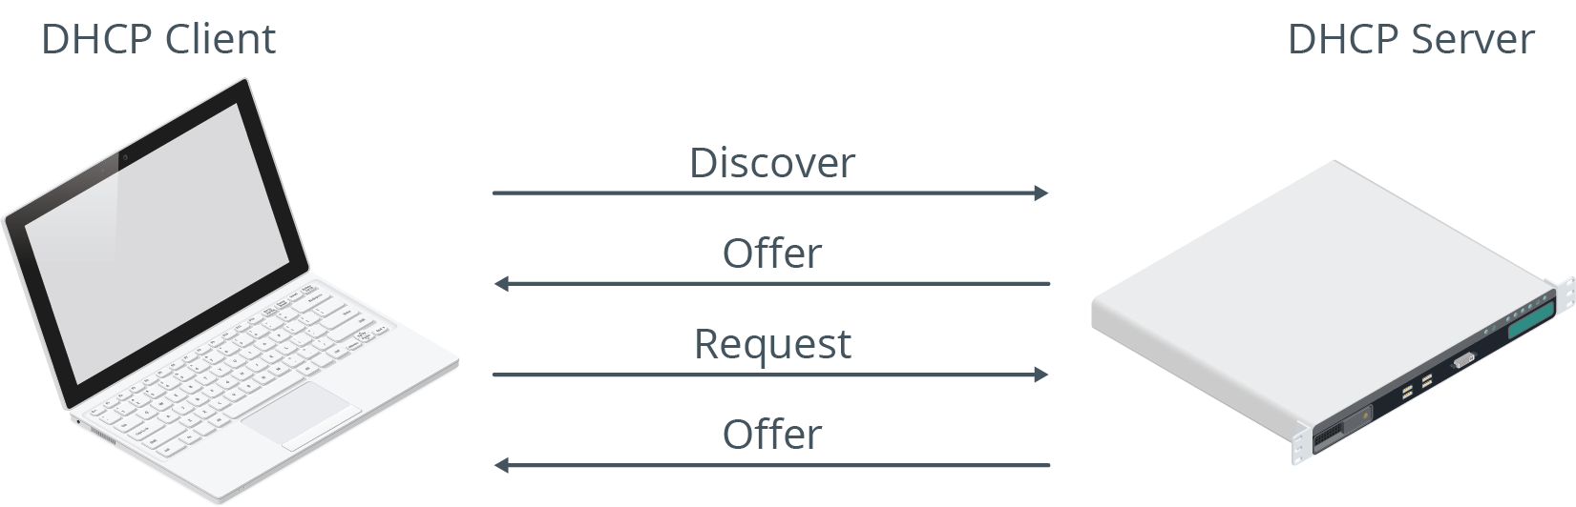
The DHCP Lease Generation and Renewal Process
Lease process initiated by clients.
Leases are temporary and need to be renewed periodically.
Leases include IP address, subnet mask, etc.
DHCP server may force client to renew lease.

Slide 98
The /etc/dhcp/dhclient.conf File
Primary DHCP client reference file.
Configures timeout values, dynamic DNS, etc.
Managed by NetworkManager.
Usually better to configure DHCP through NetworkManager.
Rather than editing file directly.
Notes:
Teaching Tip: This content focuses on just one capability of the file.

Slide 99
Name Resolution (Slide 1 of 2)
Humans have a difficult time remembering IP addresses.
Work with easy-to-remember names instead.
These names aren't useful to a computer.
Name resolution translates hostnames to IP addresses.
Can be done through static text files.
Can be done through a dynamic DNS server.

Slide 100
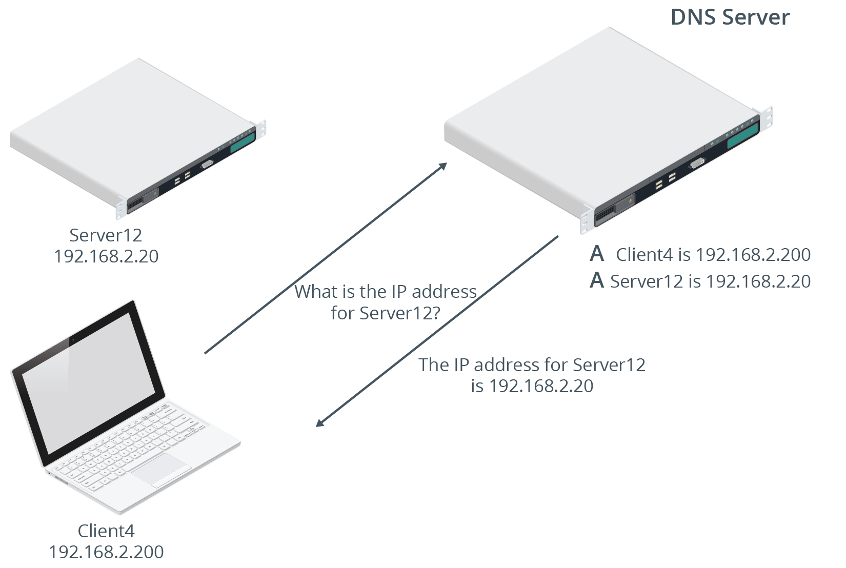
Name Resolution (Slide 2 of 2)

Slide 101
The /etc/hosts File (Slide 1 of 2)
Name resolution handled by a text file.
Lists hostnames mapped to IP addresses.
Needs to be manually updated if changes.
Not realistic in modern environments.
Can still be used in special cases.
Example: Developer system needs to connect to test server that isn't registered.

Slide 102
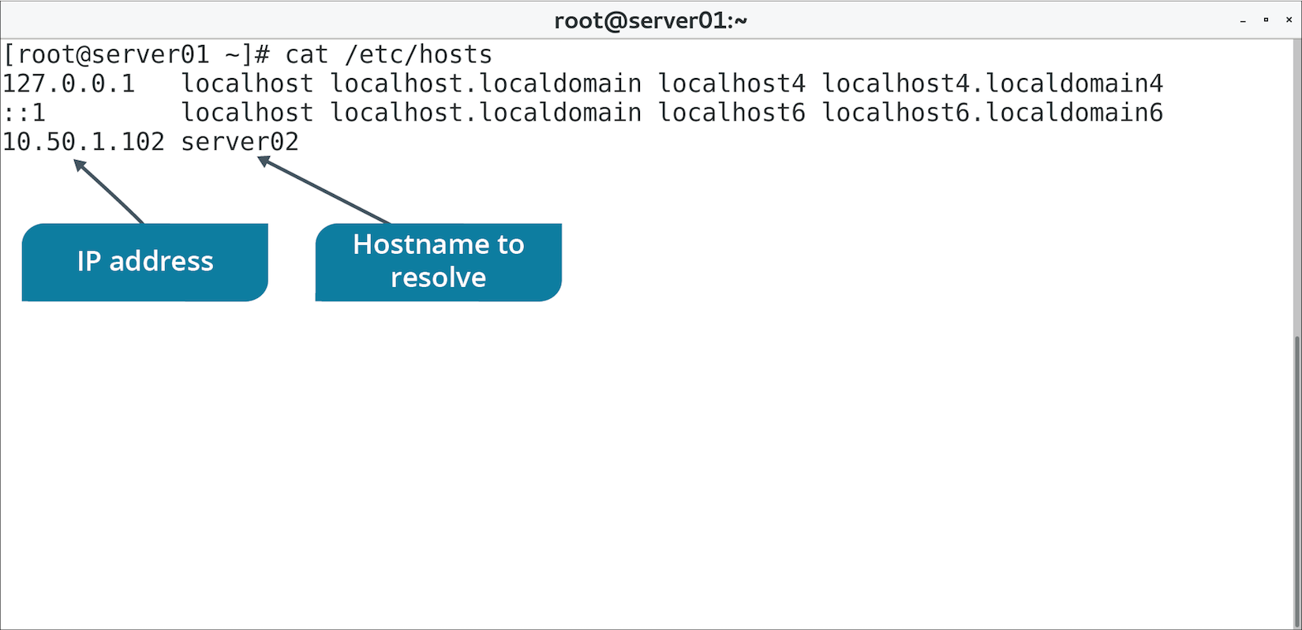
The /etc/hosts File (Slide 2 of 2)

Slide 103
The /etc/resolv.conf File (Slide 1 of 2)
DNS servers are easier to maintain than /etc/hosts file.
/etc/resolv.conf specifies IP addresses of DNS servers.
Good practice to have at least two DNS servers specified.

Slide 104
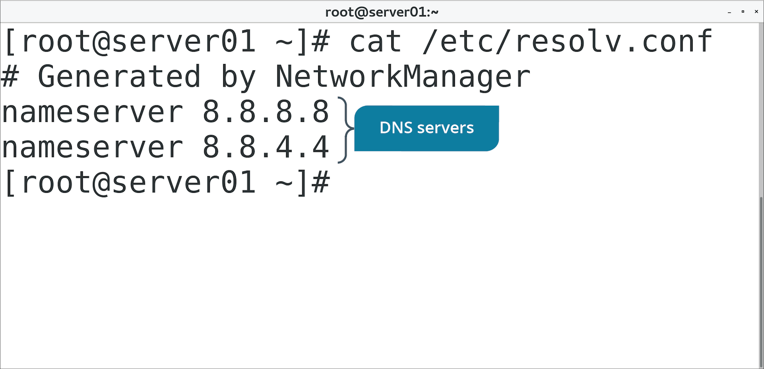
The /etc/resolv.conf File (Slide 2 of 2)

Slide 105
The /etc/nsswitch.conf Files (Slide 1 of 2)
Includes several config options for name resolution.
Defines order of name resolution options.
Preferred order:
/etc/hosts
DNS servers

Slide 106
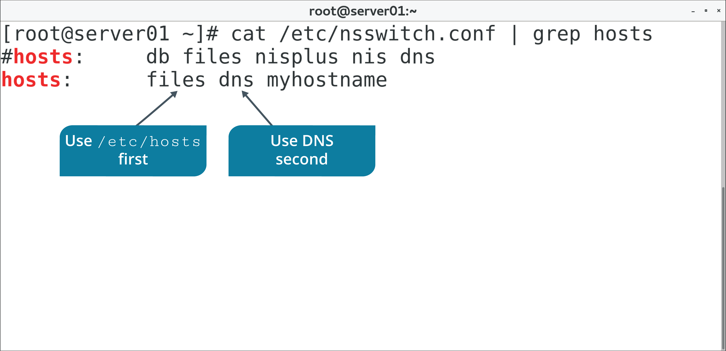
The /etc/nsswitch.conf Files (Slide 2 of 2)

Slide 107
DNS Configuration Using NetworkManager
Includes CLI, text-based, and GUI interface utilities.
Use utilities to configure IP address of at least one DNS server.

Slide 108
Discussing DHCP and DNS Client Services

Slide 109
Activity 10-6: Discussing DHCP and DNS Client Services
You have set up two internal DNS servers in your network and need to check if they're working to resolve hostnames to IP addresses and IP addresses to hostnames. Which utility can you use to do this?
ANSWER:
Any of the name resolution utilities will work: nslookup, host, or dig

Slide 110
Activity 10-6: Discussing DHCP and DNS Client Services
Your team set up a VPN connection between the main corporate office and one of your branch offices, but you cannot connect to any system in the branch office network. One of the servers at the branch office has an IP address of 192.168.1.10. Which command can you use to check the network path between your computer and that server to help troubleshoot the problem?
ANSWER:
The traceroute command is useful in checking such a connection: traceroute 192.168.1.10

Slide 111
Activity 10-6: Discussing DHCP and DNS Client Services
You installed the Apache web service on Linux server web01, but you can't connect to the web service (TCP port 80) from another computer. To begin troubleshooting, you use a utility to check TCP connections and ports that web01 is listening on. Which utility can you use?
ANSWER:
Use the ss -l command to display a list of listening sockets to determine if the web service is listening on port 80.

Slide 112
Activity 10-6: Discussing DHCP and DNS Client Services
One of the other administrators on your team patched and rebooted a server, but is worried because it is taking a long time for the server to become available again. Which utility can you use to check when the system comes back online?
ANSWER:
Use the ping command to check when the server is available on the network again.

Slide 113
Activity 10-6: Discussing DHCP and DNS Client Services
You suspect that someone is attempting to hack into one of your servers, so you decide to capture a few minutes of network traffic on that system to investigate further. Which command-line utility can you use to capture the traffic?
ANSWER:
Use the tcpdump command to capture the traffic for offline analysis.

Slide 114
Activity: Configuring a DNS Client
You need to account for human-friendly hostnames.
You'll configure name resolution to relate a hostname to an IP address.
Users can more easily refer to a specific computer on the network.
Notes:
Teaching Tip: If you haven't already, assign partners. If there are an odd number of students in class, have one partner with you, the instructor.
Teaching Tip: Students will learn more about these commands in a later topic.

Slide 115
Topic E: Configure Cloud and Virtualization Technologies
Exam Objectives:
1.5 Compare and contrast cloud and virtualization concepts and technologies.

Slide 116
Cloud Computing
The practice of delivering on-demand resources to clients over a distributed network like the Internet.
Characteristics:
On-demand self-service
Broad network access
Resource pooling
Rapid elasticity
Measured service
Has become mission-critical for many organizations.
Off-loads responsibility onto third party.
Cost, ownership, maintenance, etc.
Flexible, scalable, and supports fault tolerance.

Slide 117
Cloud Models
Model | Description
SaaS | Provides apps to end-users. Apps seem local, but are in the cloud. Deployment, maintenance, and upgrades are off-loaded.
PaaS | Virtualizes operating systems to provide to customer. Platform support is off-loaded. Targets developers and database admins.
IaaS | Virtualizes physical devices owned by provider. Hardware lifecycle responsibility is off-loaded. Targets system admins.

Slide 118
Cloud Service Providers
AWS and Microsoft Azure are the primary CSPs.
AWS is built on Linux.
Azure also supports Linux-based deployments.
Red Hat Cloud Suite is a private cloud solution.
Additional CSPs:
Google Cloud
Rackspace
Heroku
Digital Ocean
Notes:
Teaching Tip: Encourage your students to research the listed cloud service providers on their own time. Cloud services are a key component of the IT field. Many cloud solutions are either Linux-based or provide strong support for Linux servers. Many CSPs provide trial or free services for a specified period of time.

Slide 119
Cloud and Virtualization
Virtualization enables:
More efficient use of hardware.
Fault tolerance, recovery, and scalability.
Quicker deployment of services.
Virtualization is the foundation of cloud computing.
Cloud providers virtualize resources they offer to customers.
Extends to all models.
Example: Admin easily builds a cluster of systems in a single action.
Can easily tear it down when necessary.
Process can be automated.
More efficient than if using physical systems.

Slide 120
Hypervisors
A layer of software that separates a VM's software from the physical hardware it runs on.
Manages hardware allocation, networking, administration, etc.
Type 1 runs on "bare metal" of system.
VMware ESXi, Microsoft Hyper-V, etc.
Type 2 runs as a service on OS.
Oracle VM VirtualBox, QEMU, etc.
KVM is a Linux-based hypervisor.
Manages VMs with type 1 and type 2 attributes.

Slide 121
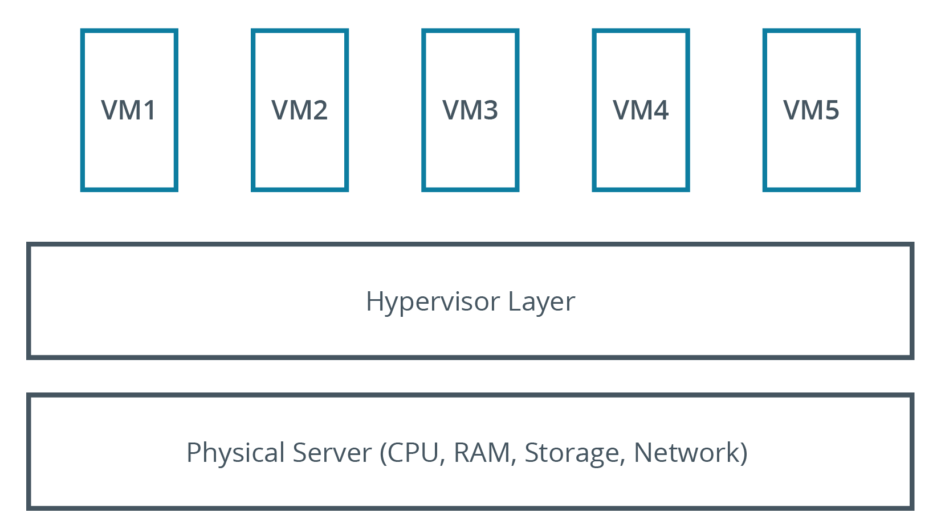
Type 1 Hypervisor

Slide 122
Templates
Template | Description
OVF | Contains config files, packages, etc. for VMs and network devices. OVA is a single package for a network appliance.
JSON | Easily interpreted by programming languages. Easy for humans to write and read. Used in quick deployment/config of VMs.
YAML | Stores config info used to deploy VMs. Can install software/create user accounts on first boot. Consists of key–value pairs.
Container images | Provides app isolation, different than VMs. Used for testing apps. Images contain everything needed to run container.
Notes:
Teaching Tip: Orchestration will be covered in more detail in a later lesson.

Slide 123
Bootstrapping
OS starts with simple layers and moves toward the complex.
VM bootstrapping is handled by virtualization layer.
You can modify deployment of VMs during bootstrapping.
Cloud-init customizes VMs during first boot.
Security settings, software, users/groups, etc.
References YAML files.
Supported by many Linux distros.
Anaconda installer configures new Linux systems.
References Kickstart files to customize install.
Installation procedures are specified in Kickstart file.
Enables rapid, consistent installation.

Slide 124
Storage
Storage exposed to VMs as virtual devices.
Files that reside on physical drive.
Treated as if it were a physical drive.
Partitioned, formatted, etc.
Virtual files provide:
Fault tolerance.
Rolling back system.
Redundancy.
Storage scalability.
Notes:
Teaching Tip: Kubernetes will be discussed in more depth in a later lesson.

Slide 125
Blob and Block Storage
Blobs store data in unstructured manner.
Binary large object.
Audio, video, text, and more types of files.
Example of object storage.
Data is written to storage device in chunks called blocks.
Files may be too large to store on one block.
Files are broken into pieces, then written as blocks.
Data is reassembled by OS.
Object storage can be more efficient for larger files.
Object storage can be more flexible when storing data in multiple regions.

Slide 126
Networking Configurations
VM can be configured with one or more NICs.
NICs can be connected to virtual switches.
Config options:
No networking
Internal
Private
Public
Manage network configs for VMs carefully.
VMs need to be protected like actual machines.
Follow security best practices for networked VMs.

Slide 127
Virtualization Tools
virsh is interactive shell to KVM virtual machines.
Subcommand | Used To
help | Get help with virsh command.
list | Get list of recognized VMs.
shutdown {VM} | Gracefully shut down VM.
start {VM} | Start VM.
reboot {VM} | Reboot VM.
create {XML file name} | Create VM from XML file.
save {VM} {file name} | Save state of VM.
console {VM} | Open console to VM.

Slide 128
Discussing Cloud and Virtualization Technologies

Slide 129
Activity 10-8: Discussing Cloud and Virtualization Technologies
Your CIO has tasked you with the job of finding an appropriate cloud service to host some of your applications. The application needs to appear as if it is locally installed. Which cloud model will you select?
ANSWER:
The Software as a Service (SaaS) offering is the appropriate choice because your CIO has tasked you with the definition of SaaS itself—applications are hosted, but behave as if they are local.

Slide 130
Activity 10-8: Discussing Cloud and Virtualization Technologies
Executive management has decided to move toward a more agile infrastructure with mobile users and 100 percent hosted applications and infrastructure. This option enables employees to work from any location and relieves the company of hardware lifecycle and application support. Which option has the executive management decided to move to?
ANSWER:
Public cloud offerings provide companies with off-premise infrastructure with some control of resources, but without the responsibility of maintaining the hardware and software support.

Slide 131
Activity 10-8: Discussing Cloud and Virtualization Technologies
To move to a public cloud offering for your company's applications, you respond with the recommendation of using one of the two primary cloud service provider (CSP) companies. What are the two primary CSP companies from which to choose?
ANSWER:
Amazon (Amazon Web Services) and Microsoft (Microsoft Azure).

Slide 132
Activity 10-8: Discussing Cloud and Virtualization Technologies
Your company needs to transition from individuals running virtual machines locally on workstations to deploying virtual machines company-wide. Your team determines that it is more cost-effective for you to use VMware ESXi. VMware ESXi is which type of hypervisor? What does this mean?
ANSWER:
VMware ESXi is a type 1 hypervisor. This means that the hypervisor runs on "bare metal" rather than on top of an existing operating system.

Slide 133
Activity 10-8: Discussing Cloud and Virtualization Technologies
There is much debate among your team concerning whether to deploy virtual machines with thick-provisioned storage or thin-provisioned storage. What the debate boils down to is performance. Which provisioning type has better performance?
ANSWER:
Thick provisioning has better performance because all space is allocated at configuration time and the storage capacity is fixed rather than dynamic. Fixed capacity has better performance because there is no wait for expansion in the case of thin-provisioned storage.

Slide 134
Activity: Configuring Virtualization
A developer wants a test environment for a new app.
She wants to be able to revert environment for each test.
You'll install a KVM solution for her.
Notes:
Teaching Tip: If students would rather not manually type this command, they can run yum-script.sh with superuser privileges instead. Or, they can copy and paste the command from that script into their terminal.
Teaching Tip: Students will learn more about package management with yum and other tools in the next lesson.
Teaching Tip: Students will use this VM to install Linux at the end of the class.
Teaching Tip: Students will work with this VM some more in the next lesson.

Slide 135
Topic F: Troubleshoot Networking Issues
Exam Objectives:
1.3 Given a scenario, configure and verify network connection parameters.
4.1 Given a scenario, analyze system properties and remediate accordingly.

Slide 136
Common Networking Issues
Check the basics:
Is the device powered, plugged in?
Is NIC "down"?
Is interface configured correctly?
Gather driver info about NIC using ethtool command.
Troubleshoot name resolution:
Ping by both hostname and IP address.
If IP address succeeds but hostname doesn't, there is a problem with name resolution.
Use tools like nslookup to test name resolution.
Troubleshoot network itself:
Latency, saturation, dropped packets, timeouts, etc.
Router may be misconfigured.
Escalate to network team.

Slide 137
The ping Command
Used to send test packets between systems on a network.
Sending computer looks for a reply from destination computer.
Outcomes:
Reply from <host>
Destination unreachable
Timeout
Notes:
Teaching Tip: Consider mentioning that, in some environments, ICMP traffic may be blocked altogether.

Slide 138
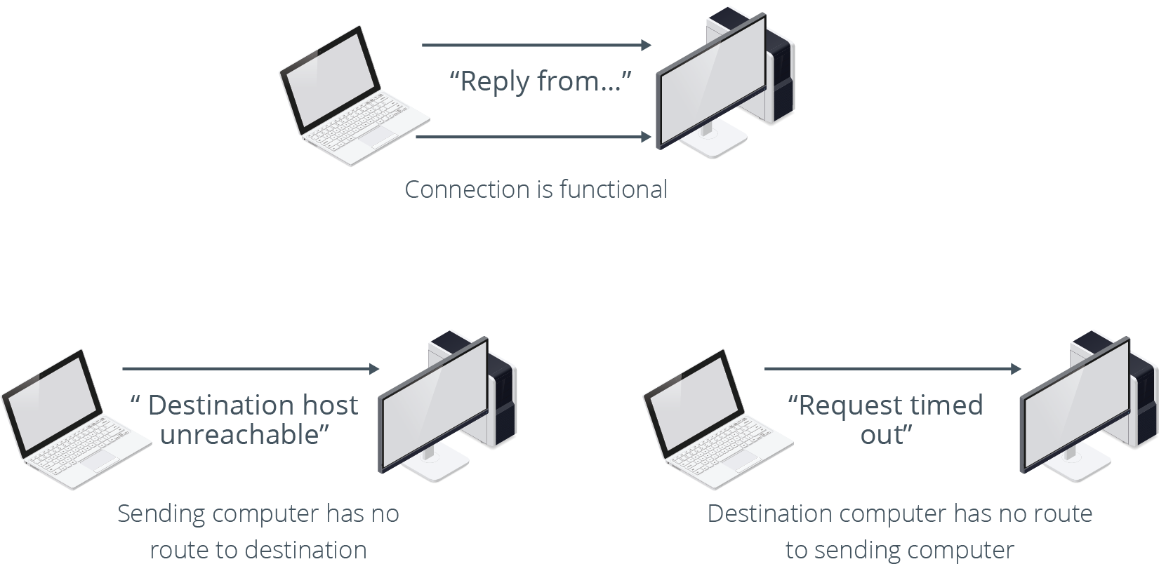
Pinging Results

Slide 139
The traceroute and tracepath Commands (Slide 1 of 2)
traceroute is used to report network path between computers.
Includes routers along the way.
Used for troubleshooting connectivity.
Can identify where connection failed.
tracepath is a simplified version.
No root privileges necessary.
Fewer options.

Slide 140
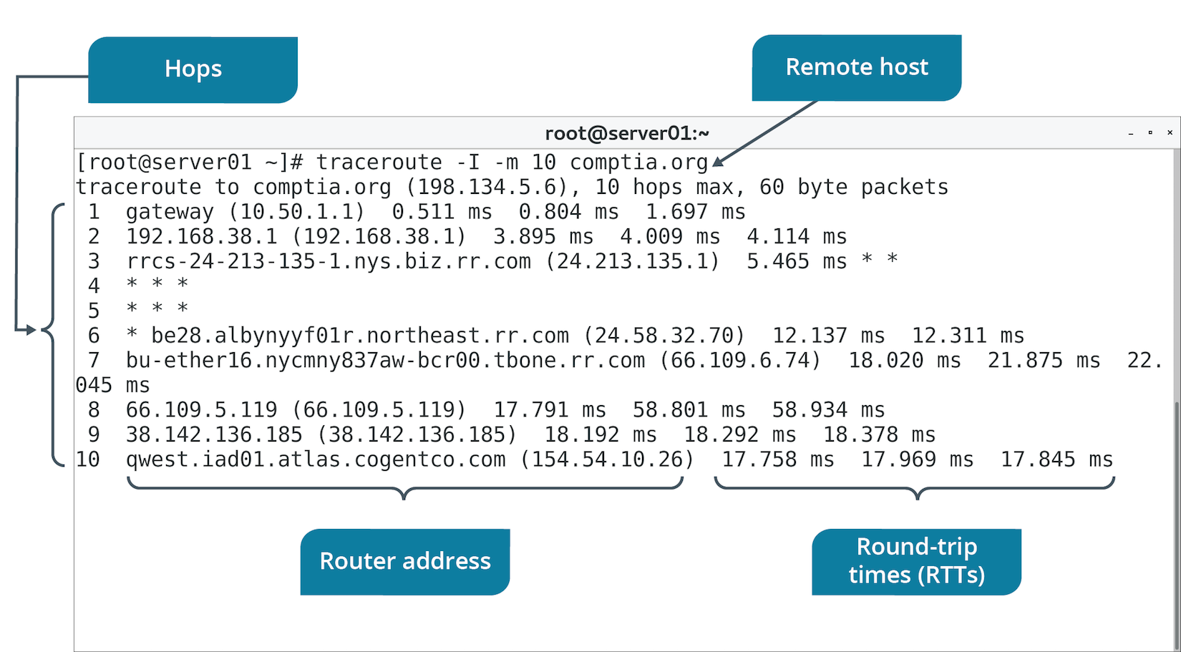
The traceroute and tracepath Commands (Slide 2 of 2)

Slide 141
The netstat Command
Gathers info about TCP connections on system.
Existing connections, listening ports, NIC info, etc.
Deprecated in favor of ss command.
Option | Used To
-v | Activate verbose mode.
-i [interface] | Display info about all network interfaces or interface specified.
-c | Continuously print info every second.
-l | Show only what ports are being listened on.

Slide 142
The ss Command (Slides 1 of 2)
Similar to netstat but with simpler output/syntax.
Can gather info on TCP connections.
Can gather info on clients that are connected.
Option | Used To
-l | Show currently listening sockets.
dst {host} | Show whether host is connected and its stats.
-i | Show only what ports are being listened on.

Slide 143
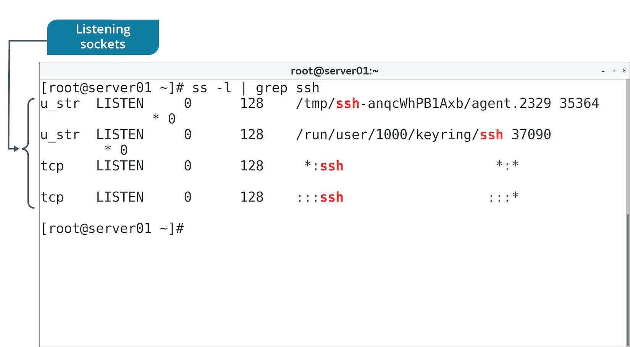
The ss Command (Slides 2 of 2)

Slide 144
The dig, nslookup, and host Commands
All used to test name resolution.
Command | Description
dig | Outputs IP address mapped to domain, answering DNS server, and time taken to receive answer. Example: dig @{IP address} {domain name}
nslookup | Has interactive and non-interactive mode. Example: nslookup {domain name}
host | Simple tool. Example: host {domain name} {IP address}

Slide 145
The ip Command for Troubleshooting
Use ip addr to verify network configuration is accurate.
Link-local address indicates misconfiguration.
Check NIC's status as either up or down.
Use -s option to view connection usage stats.

Slide 146
The route Command (Slide 1 of 2)
Linux can be configured as a router.
Includes routing table entries.
route command displays and manages routing table.
Command | Used To
route | View current routing table.
route add default gw {IP address} | Configure default gateway by IP address.
route add –host {IP address} reject | Filter traffic based on specified IP address.

Slide 147
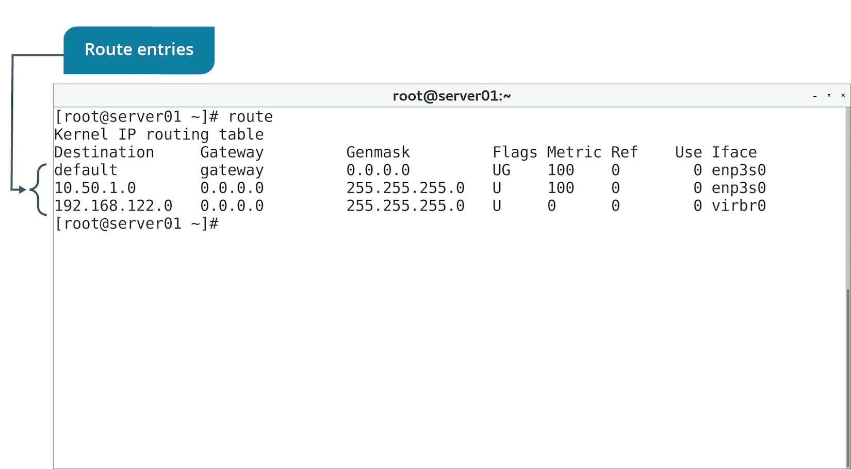
The route Command (Slide 2 of 2)

Slide 148
The nmap Command (Slide 1 of 2)
Maps a network environment.
Identifies nodes and reports OS, service info, addresses, and much more.
Has many options.
GUI version called Zenmap.
Can audit/document network.
Vital in troubleshooting.
Troubleshooting example:
ip addr
ping {destination}
nmap
Notes:
Teaching Tip: Consider pointing out that tools like Nmap and Wireshark are also used by attackers, and that their use may be discouraged or banned in students' organizations.

Slide 149
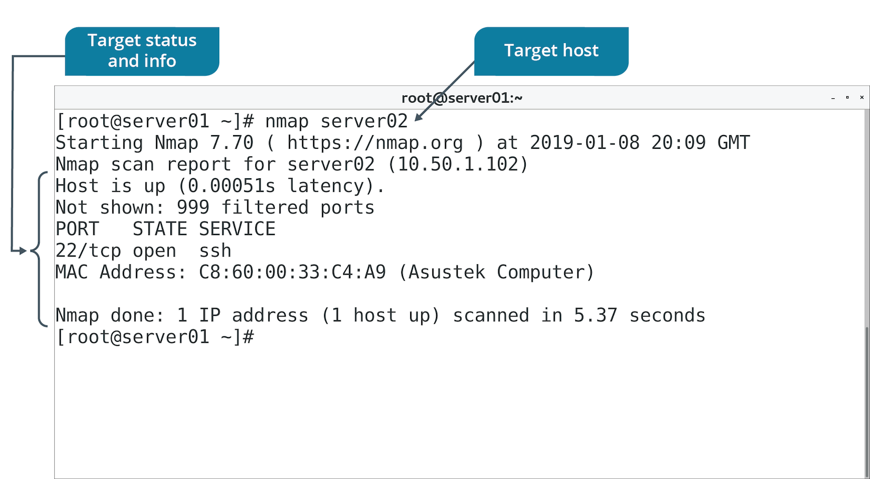
The nmap Command (Slide 2 of 2)

Slide 150
Wireshark (Slide 1 of 2)
A common network packet sniffer and analysis tool.
Can intercept and potentially read network traffic.
Info includes source/destination addresses, port numbers, payload, etc.
Can show what packets are/are not moving through a segment or NIC.
Troubleshooting example:
ip addr
ping {destination}
firewall-cmd --list-services
Wireshark

Slide 151
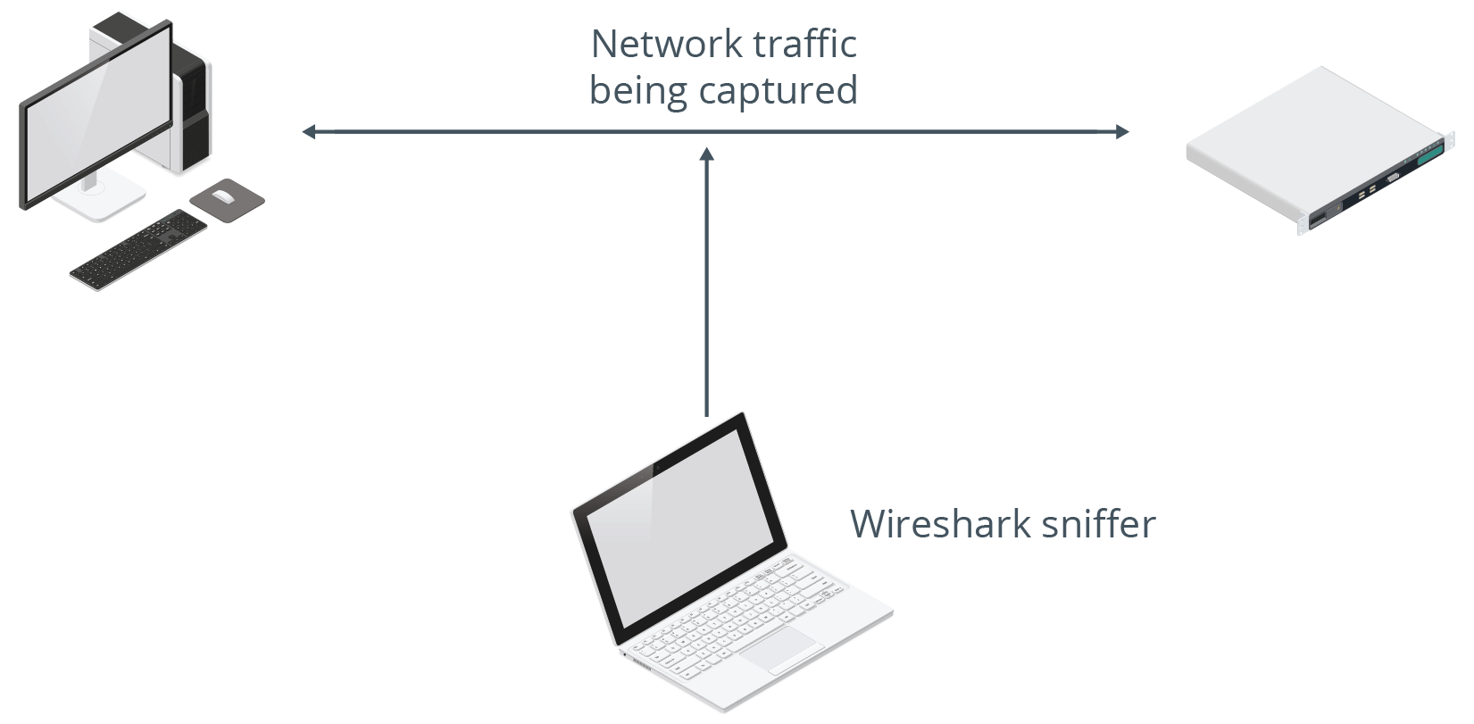
Wireshark (Slide 2 of 2)

Slide 152
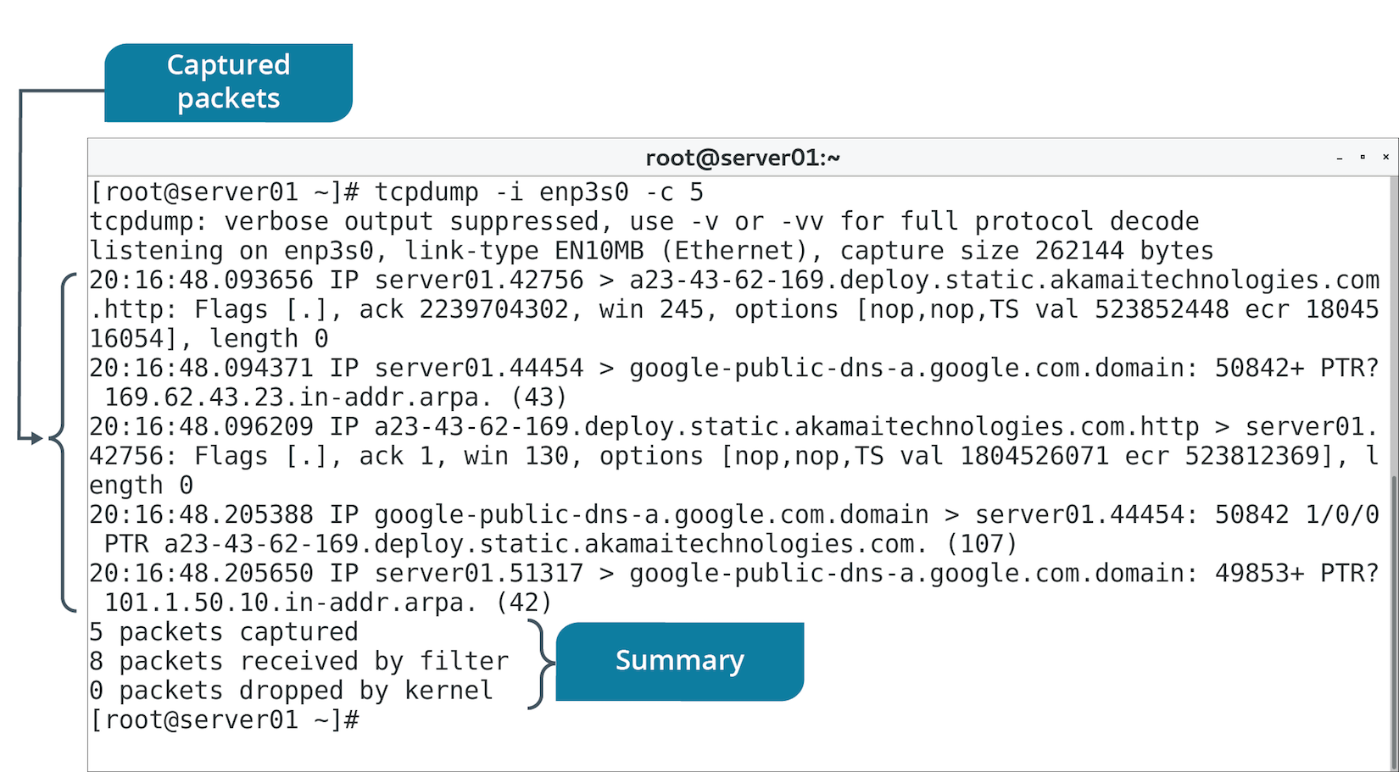
The tcpdump Command (Slide 1 of 2)
Similar to Wireshark, but in CLI form.
Installed on most distros.

Slide 153
The tcpdump Command (Slide 2 of 2)
Option | Used To
-i | Specify interface to use.
-n | Not resolve hostnames.
-v | Specify verbose mode.

Slide 154
The netcat Command
Can test connectivity over a network.
Can listen on a destination computer and attempt to connect to source.
Use Case | Command Example
Connect two computers to transfer data | On comp1 (listen on port): netcat -l 4242 On comp2 (connect to listener): netcat comp1 4242
Transfer files between two computers | On comp1 (listen on port): netcat -l 4242 > received.file On comp2 (connect to listener): netcat comp1 < original.file
Port scan a computer | netcat -z -v domain.tld 1-1000

Slide 155
The iftop Command (Slide 1 of 2)
Displays bandwidth usage.
Can reveal NIC/protocol consuming most bandwidth.
Use to identify why a link may be slow.
Example: iftop -i eth0
Network slowness may be symptom of bandwidth saturation.
Bandwidth capacity is being used up.
Use iftop to identify excessive incoming/outgoing traffic on a NIC.
Use to identify offending host(s).
Take steps to stop offending host(s) from saturating network.

Slide 156
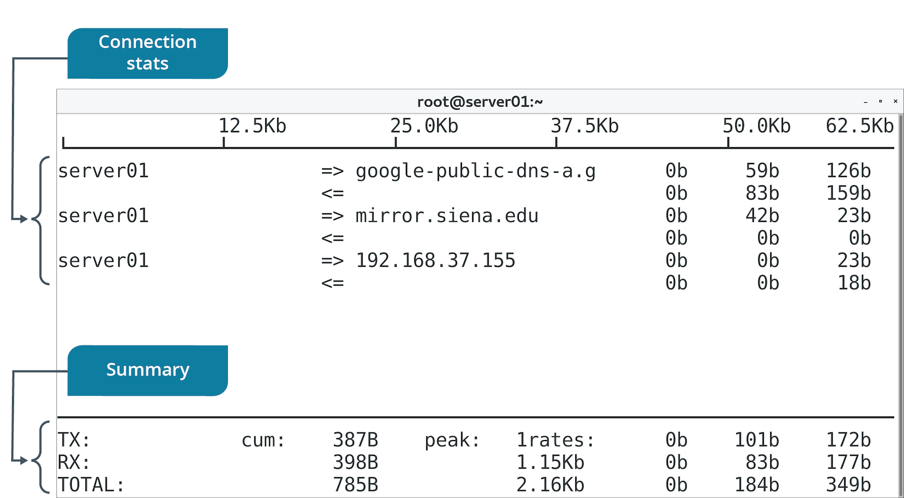
The iftop Command (Slide 2 of 2)

Slide 157
The iperf Command (Slide 1 of 2)
Tests max throughput for an interface.
Installed on two endpoint systems.
One is server, the other client.
Client is being tested.
Use to ensure throughput is meeting expectations.
Basic test:
On server, run iperf -s
On client, run iperf -c {server address}
Examine results.

Slide 158
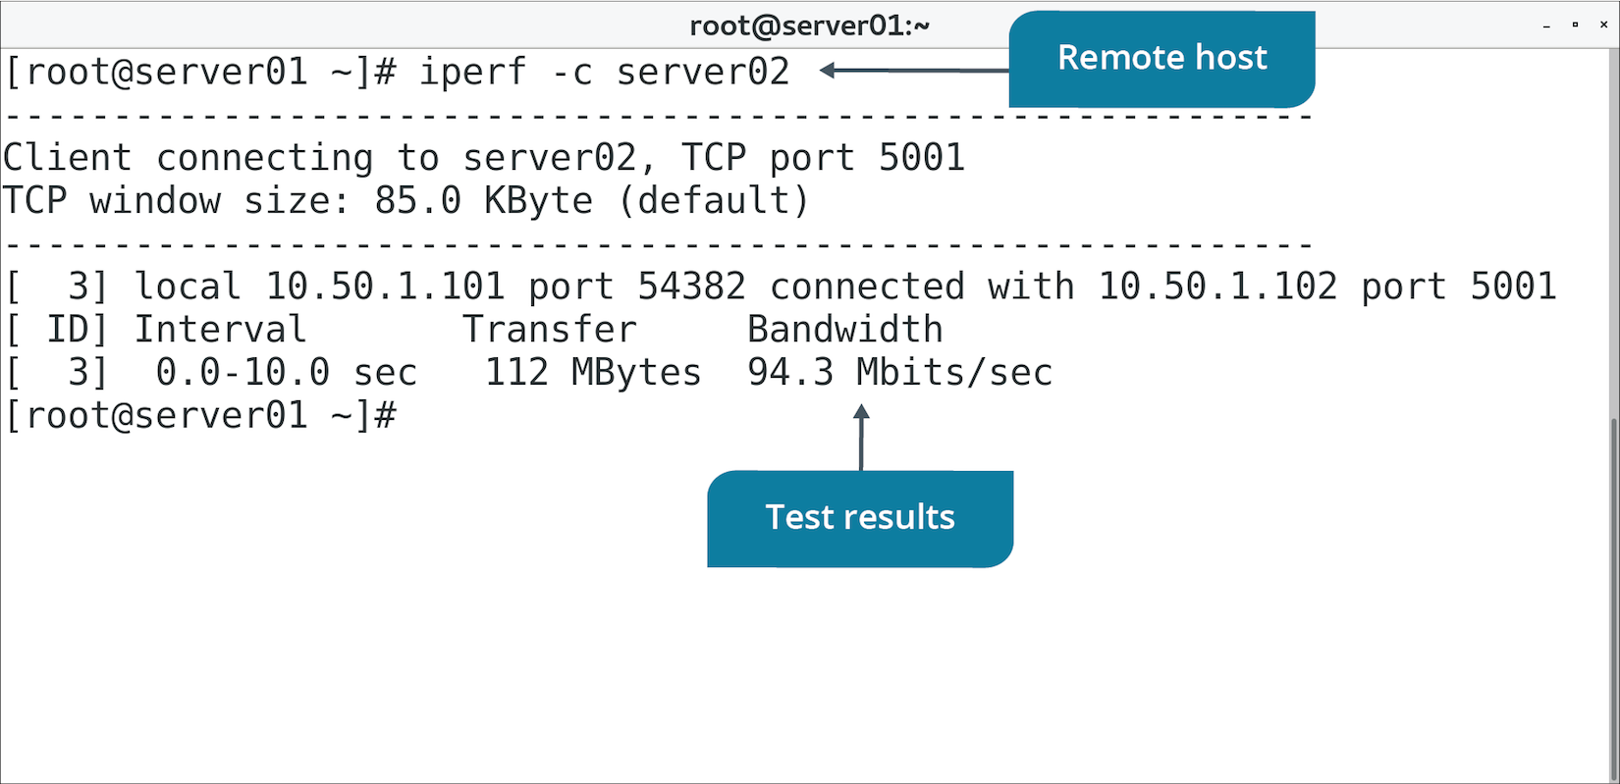
The iperf Command (Slide 2 of 2)

Slide 159
The mtr Command (Slide 1 of 2)
Combines ping, traceroute, and more for testing connection quality.
Packets sent to destination in large groups.
Time taken for response is noted.
Takes note of lost/dropped packets.
Packets can't reach destination.
Can lead to latency or lost data.
Many lost packets indicate an issue on the path.
mtr outputs percentage of packets lost.
High percentage on a node may suggest it is faulty.
Notes:
Teaching Tip: A similar tool in Windows is PathPing.

Slide 160
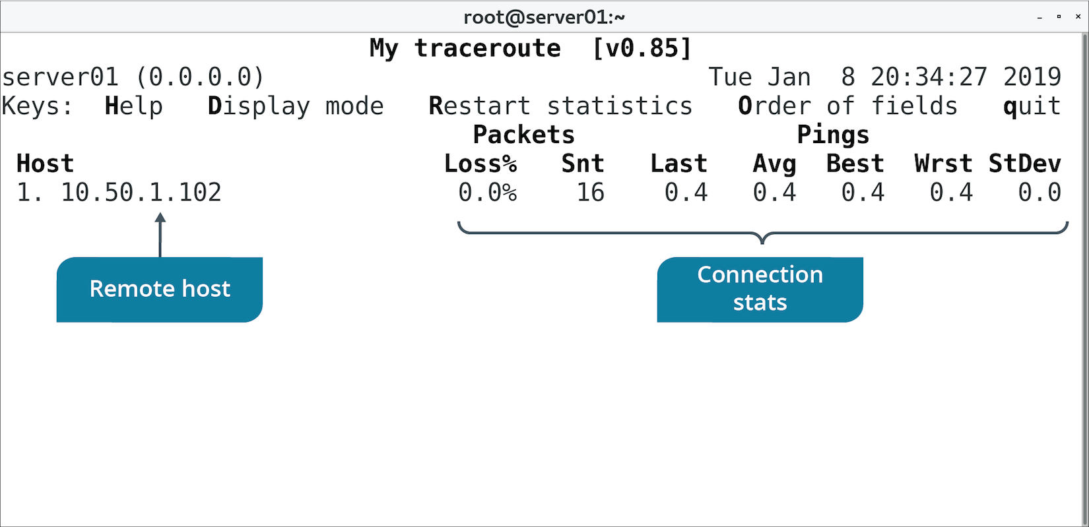
The mtr Command (Slide 2 of 2)

Slide 161
The arp Command (Slide 1 of 2)
ARP relates IP addresses and MAC addresses.
arp command discovers info about known MAC addresses.
Computers cache resolved IP/MAC address combinations.
Incorrect or out-of-date info can lead to lost connectivity.
ARP cache can be cleared to troubleshoot.
arp -d {IP address} to clear entry.
arp -a to view cache.

Slide 162
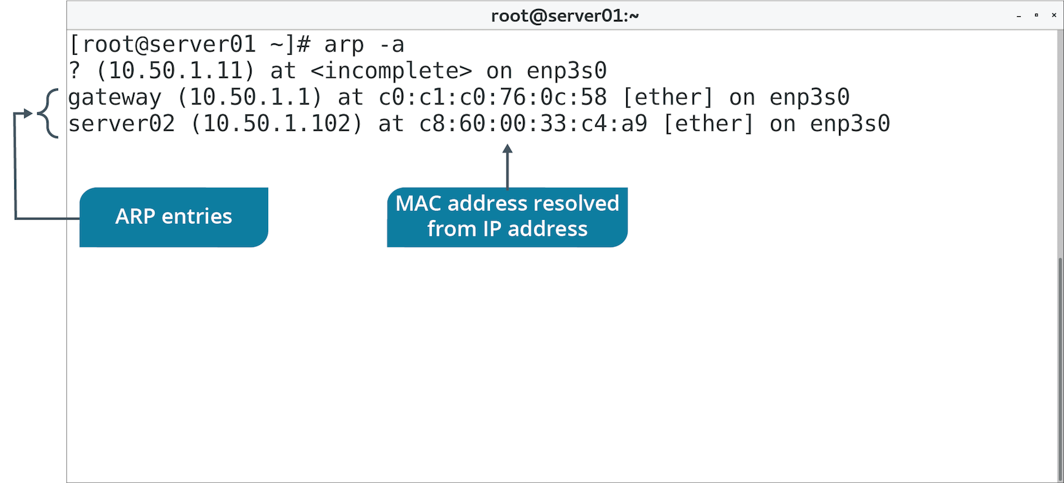
The arp Command (Slide 2 of 2)

Slide 163
The whois Command (Slide 1 of 2)
Provides info on Internet DNS registration.
Use to learn or verify domain name ownership, contact info, etc.
Examples:
whois google.com
whois ubuntu.com
whois redhat.com

Slide 164
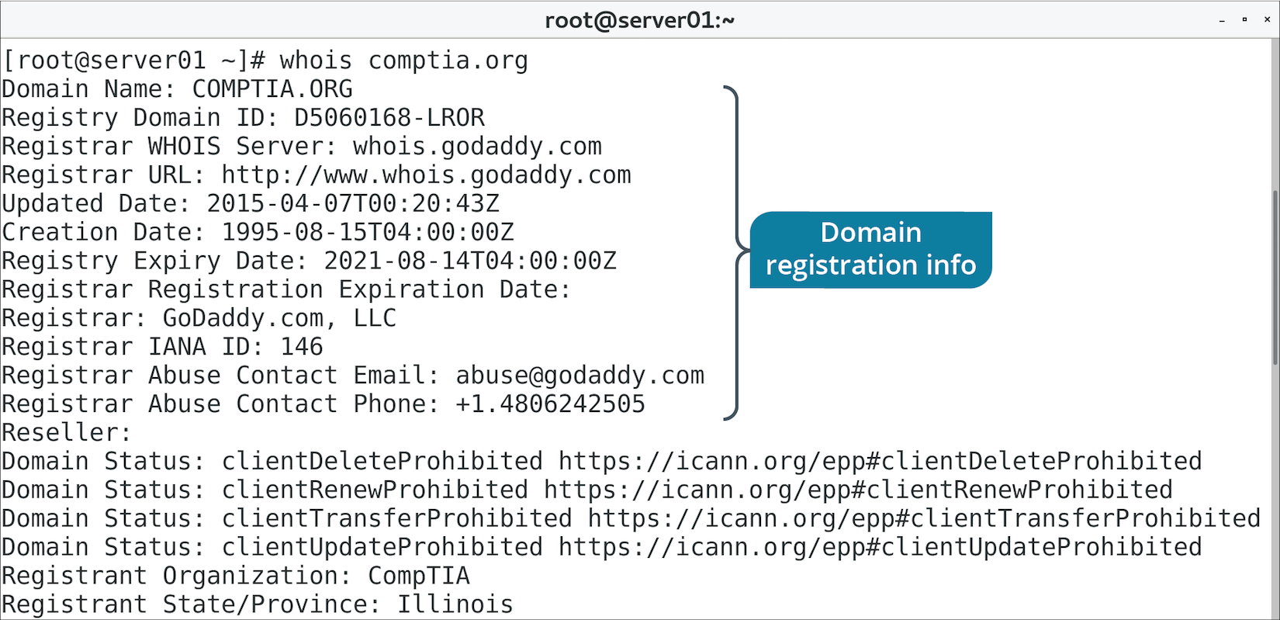
The whois Command (Slide 2 of 2)

Slide 165
Guidelines for Troubleshooting Networking Issues
Narrow the scope of the problem.
Verify IP address config using the ip command.
Diagnose bandwidth issues during slow network performance.
Use iperf to test max throughput if bandwidth is not the issue.
Use general tools:
Use ping to test connectivity.
Use traceroute to understand network between two endpoints.
Use nslookup to test name resolution.
Use ethtool to verify NIC config.
Use virsh to manage KVM virtual machines.
Use iperf to test throughput between endpoints.

Slide 166
Discussing Networking Issues

Slide 167
Activity 10-10: Discussing Networking Issues
You're asked to design the network service implementation at a branch office location. There will be servers, printers, and workstations in the office. Which approach for assigning IP addresses to workstations would you take?
ANSWER:
Dynamic IP address configurations are usually appropriate for client machines (workstations). They may also be used for network print devices.

Slide 168
Activity 10-10: Discussing Networking Issues
Your team has decided to use only one internal DNS server and one external. You must change the DNS server IP addresses on every Linux server. Which file can you edit to change the IP addresses?
ANSWER:
The /etc/resolv.conf file contains the IP addresses of DNS servers.

Slide 169
Activity 10-10: Discussing Networking Issues
Why do we use a service such as DNS to map IP addresses to names?
ANSWER:
Because IP addresses are difficult to remember, and names are easier for humans to remember.

Slide 170
Activity 10-10: Discussing Networking Issues
You're assisting a group of web developers to set up their test systems, but you don't want other users to know about them, so you aren't registering them with your network DNS servers. Instead, you're helping the developers edit a local file on their systems that will act as a local IP address-to-name mapper. Which file can you edit for this private name resolution service?
ANSWER:
Edit the /etc/hosts file on each developer's workstation to map the test systems' IP addresses to names.

Slide 171
Activity 10-10: Discussing Networking Issues
Your team is setting a standard for the /etc/nsswitch.conf file. After some debate, the team decides to use the preferred configuration for the ordering of name lookup services. What order is this?
ANSWER:
The preferred configuration is /etc/hosts and then DNS.

Slide 172
Activity: Testing the Network Environment
You want to use tools to better understand Develetech's network.
These will help diagnose/solve issues related to:
Latency.
Lack of hostname resolution.
Inability to connect to other hosts.
And more.

Slide 173
Activity: Troubleshooting Networking Issues
Server team has compiled a list of common issues.
Consider the following scenarios and suggest Linux tools and procedures.
You'll make troubleshooting more efficient and effective.

Slide 174
Activity 10-12: Troubleshooting Networking Issues
Rose Stanley calls the help desk, registering a ticket that her Linux workstation does not have network connectivity. What process and tools might you suggest?
ANSWER:
Answers may vary, but could include: a) Confirm the network cable is plugged in properly; b) Use the ip addr command to verify whether she has a valid IP address configuration. If the 169.254.x.x IP address is returned, her machine is not able to lease an IP address from the DHCP server; c) Attempt to ping one of the servers on the network that Rose might connect to. If the ping returns a "destination host unreachable" message, there is likely a configuration error on her Linux workstation; and d) Use traceroute to attempt to connect to a server. If the traceroute fails at a particular "hop" or router along the path, there is likely a configuration issue at that router.

Slide 175
Activity 10-12: Troubleshooting Networking Issues
A change has been made to the configuration of a router by a member of the network team. Unfortunately, the change was not documented and the team member is unavailable. You have no access to the router itself. You would like to investigate what network traffic is moving on each side of the router to help determine what ports might have been closed. What tools might you use to gather network traffic on each side of the router?
ANSWER:
Answers may vary, but could include tools like tcpdump and Wireshark.

Slide 176
Activity 10-12: Troubleshooting Networking Issues
What steps might you take to implement a plan of action regarding the gathering of network traffic?
ANSWER:
Answers will vary, but might include: a) Use a packet sniffer like Wireshark to observe what traffic is destined for the router on one segment; and b) Use a packet sniffer on the other segment to observe what traffic has been passed through the router, and what traffic has not. You can begin to infer what traffic is being blocked by the router with this information.

Slide 177
Activity 10-12: Troubleshooting Networking Issues
The Develetech IT staff recognizes the importance of solid documentation and wants to generate a representation of the entire network. The staff wants the information to include all routers and servers, as well as listening services and operating system information for each server. What tool might you suggest for this project?
ANSWER:
Answers may vary, but nmap is one of the most useful tools for this job.

Slide 178
Activity 10-12: Troubleshooting Networking Issues
A junior Develetech server administrator believes that the bandwidth usage on his Linux server is being consumed by a particular network service. What tool could you suggest to him to gather information about exactly what protocols are using bandwidth on the NIC?
ANSWER:
Answers may vary, but iftop is one of the most useful tools for this job.

Slide 179
Activity 10-12: Troubleshooting Networking Issues
After the administrator gathers the desired information, he discovers that there is no unexpected bandwidth usage by the services. He wonders if perhaps there is an issue on the network itself. He asks for a utility that would enable him to empirically test network bandwidth between two servers. What might you suggest?
ANSWER:
Answers may vary, but iperf is one of the most useful tools for this job.

Slide 180
Activity 10-12: Troubleshooting Networking Issues
One of Develetech's server administrators is having difficulties with name resolution. She is responsible for both Linux and Windows servers. She wants to know if there is a single tool she can run from both of her servers to confirm they are receiving name resolution information from a specific DNS server.
ANSWER:
Answers may vary, but nslookup is one of the most useful tools for this job.

Slide 181
What kind of network services does your organization provide to employees and customers?
Does your organization leverage cloud or virtualization technologies? If so, what resources use these technologies? If not, do you see these technologies being a benefit to the organization?

